Slide 1
Wednesday, September 2nd
Kitchen Resource Management Unit: Ch. 8
Bell Ringer: Define Work Centers (151), Work Triangles (152), Universal Design (153), and the difference between Natural and Artificial Light (156)
REMINDER: Those who didn’t take the Sanitation
Test have until this Friday to make up… no longer accepted after that time.

Slide 2
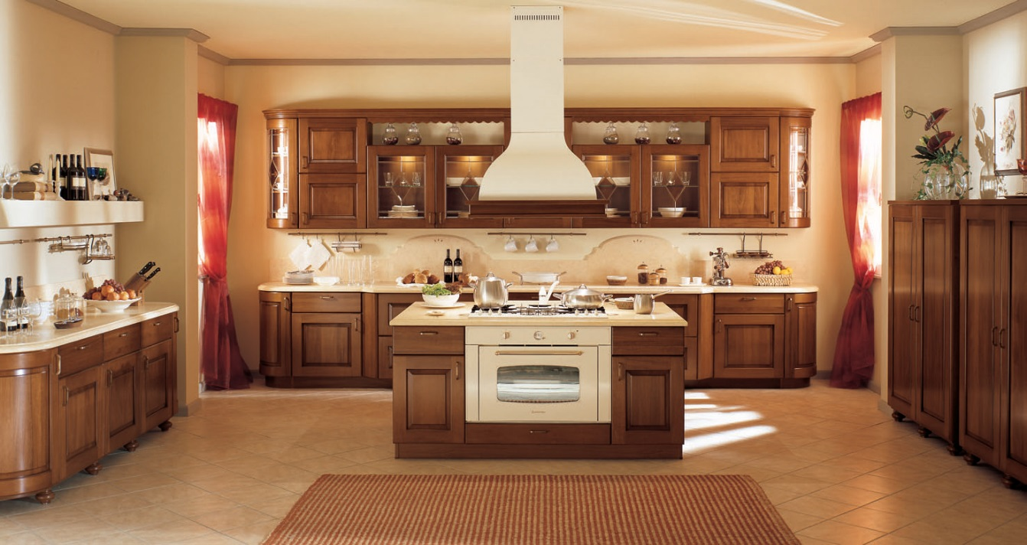
Agenda: Ch. 8 Kitchen and Dining Areas
Planning the Kitchen and Dining Areas
Finding our kitchen triangles
Kitchen and Dining Area Design
Wall / floor coverings
Countertops, Cabinets, and Lighting
Ventilation and Electrical Wiring

Slide 3
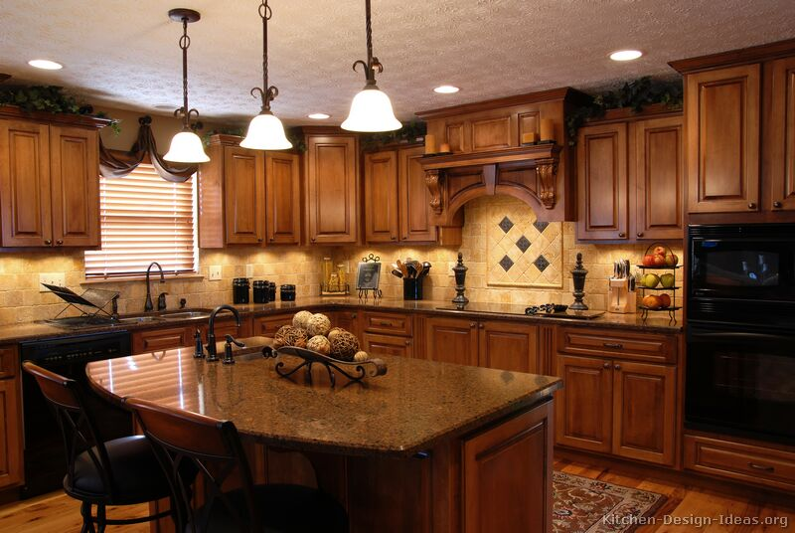
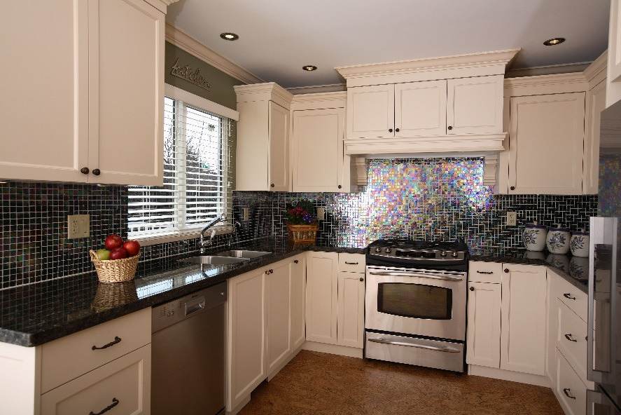
Planning the Kitchen and Dining Areas
Food Prep and Storage
Refrigerator / Freezer
Cooking and Serving
Range / Oven (one side min. 24” Counter space)
Cleanup
Sink / Dishwasher / Trash
Three Main Work Centers

Slide 4
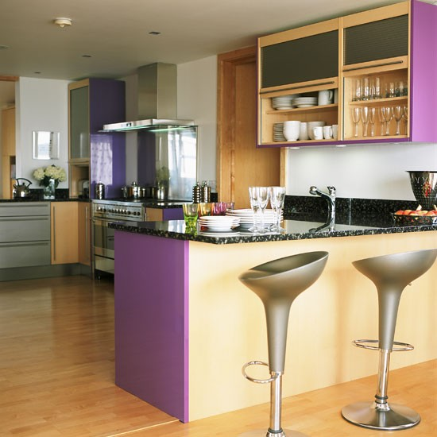
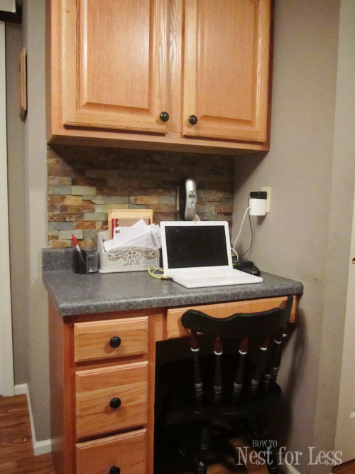
Planning the Kitchen and Dining Areas
Counter between range and fridge
Mixing station (min. 36” wide)
Eating Center
18-24” per person
At least 15” deep
Separate table (30” clearance around)
Planning Center
Additional Work Centers

Slide 5
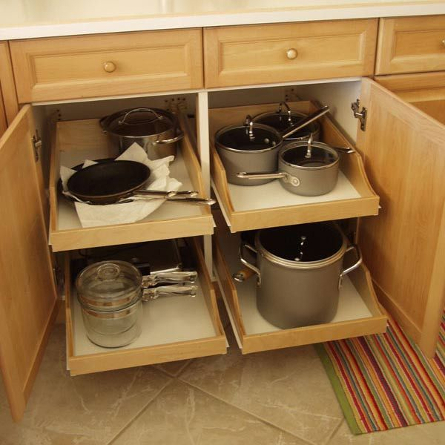
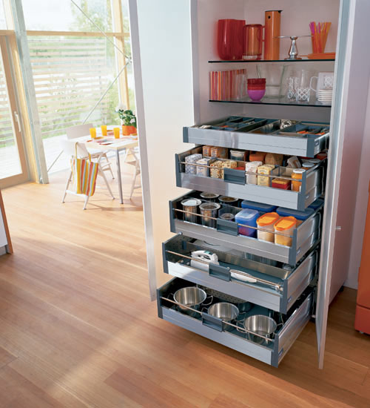
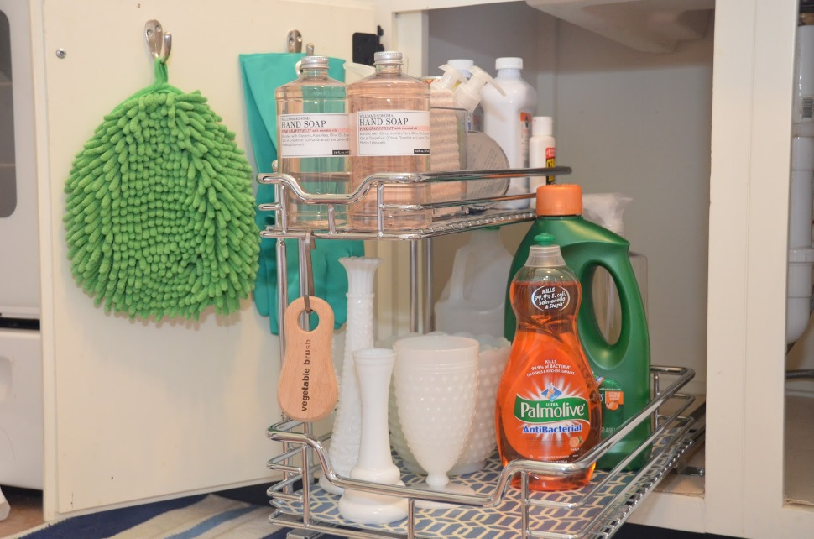
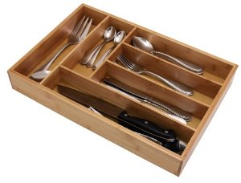
Kitchen Storage Space
Why do we store where we do?
Where you will be using them?
How often do you use them?

Slide 6
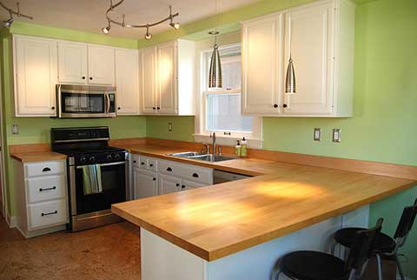
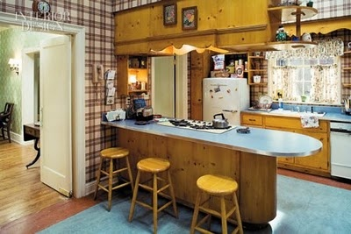
Work Triangle and Floor Plans
Benefits…
U-Shaped
L-Shaped
Corridor
One-wall
Island Peninsula

Slide 7
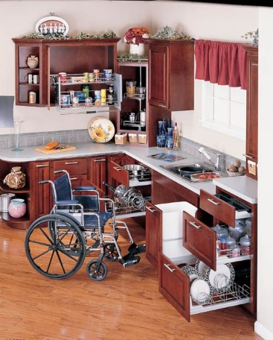
Universal Design
Features of rooms, furnishings, and equipment that are usable by as many people as possible
Peninsula, U-shaped, and L-shaped good examples
Compact work triangle – less energy

Slide 8
Kitchen and Dining Area Design
Wall Coverings
Floor Coverings
Countertops and Cabinets
Lighting and Ventilation
Electrical Wiring
Low-Cost Redecorating
Read pg. 155

Slide 9
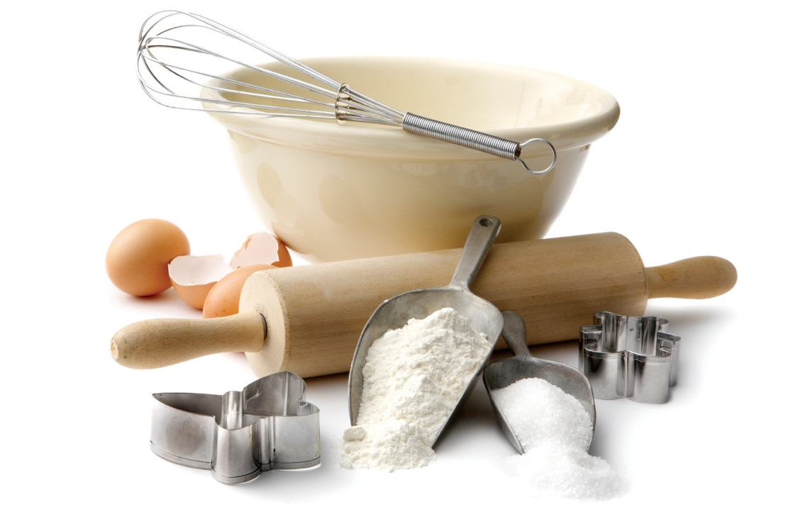
Friday, September 4th
Bell Ringer: Read the Baking Tools section on page 187 – 188. Explain at least 5 tools and their uses.
REMINDER: Don’t forget to turn in your Blue Kitchen Design Sheet as well as your Designing a kitchen graph paper.

Slide 10
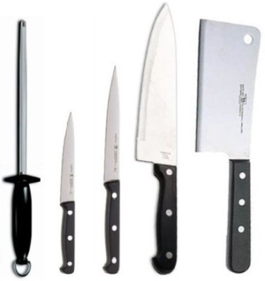
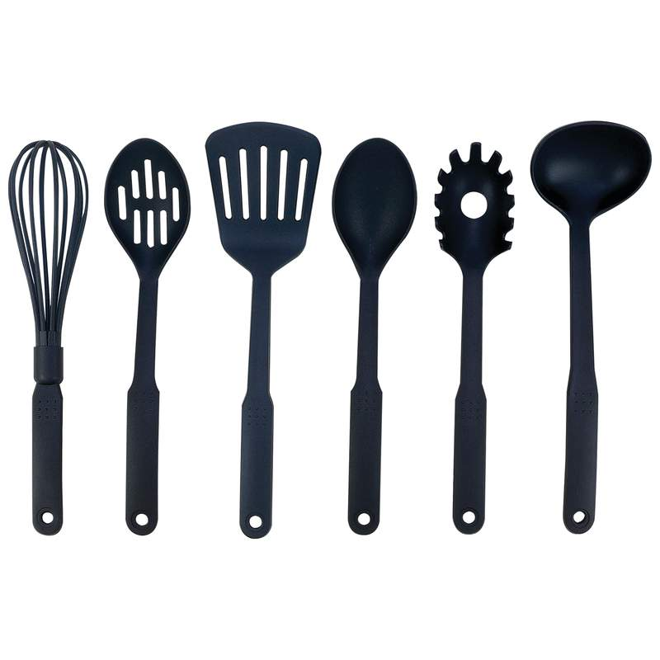
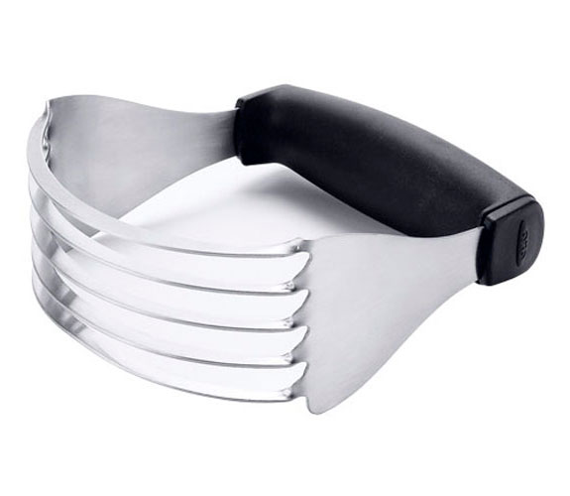
Agenda: Ch. 10 Kitchen Utensils
Small Equipment
Cooking and Baking Utensils
Activity – practice knife skills

Slide 11
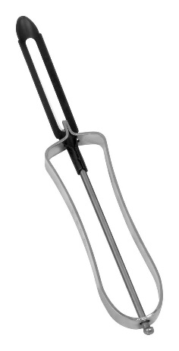
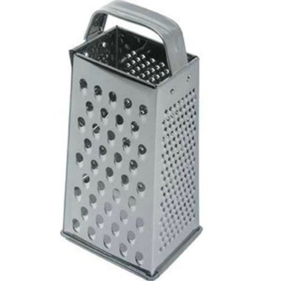
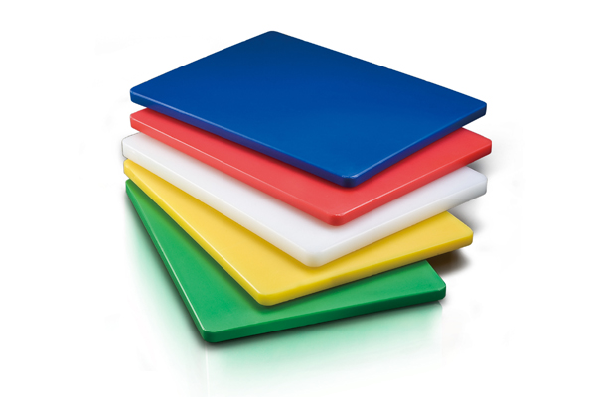
Cutting Tools
Kitchen Shears
Poultry Shears
Peeler
Shredder / Grater
Cutting Boards
Would you know when to use it?
What is their purpose?
Could you recognize them from a picture?
Where do they go in the kitchen?

Slide 12
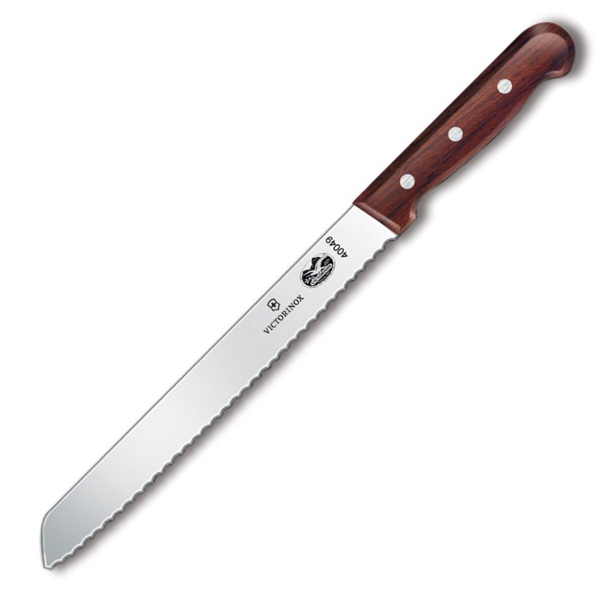
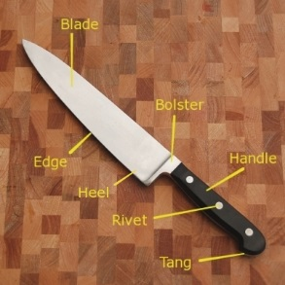
Knives
Blade
Stainless and Carbon Steels
Handles
Wood, Plastic, Bone
Tang
Rivets
Common
French (Chef) knife
Slicing Knives
Utility
Paring
Serrated
Jaime Oliver Skills
5 min. video

Slide 13
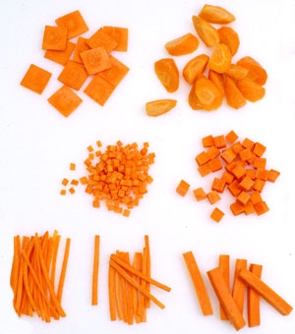
Knife Cuts
Dice (brunoise, small, medium, large)
Julienne (Carrots)
Chop (green onion)
Mince
Slice (cucumbers)
Chiffonade (lettuce)

Slide 14
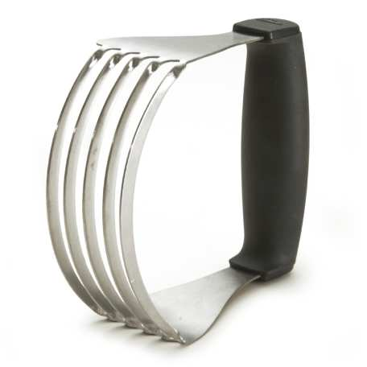
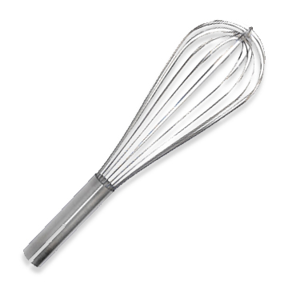
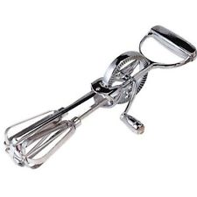
Mixing Tools
Would you know when to use it?
Wooden Spoons
Slotted Spoons
Heavy Metal Spoons
Rotary Beater
Whisk
Hand Held Mixer
Stand Mixer
What is their purpose?
Could you recognize them from a picture?
Where do they go in the kitchen?

Slide 15
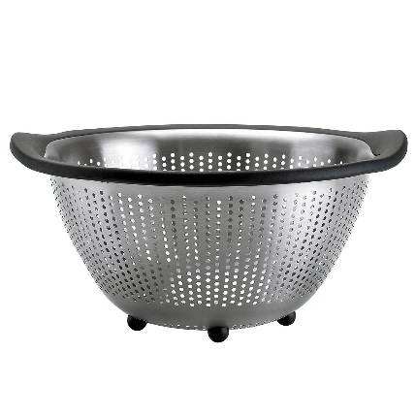
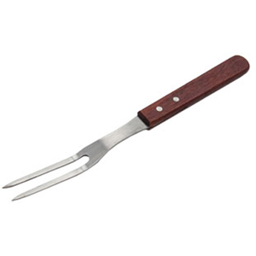
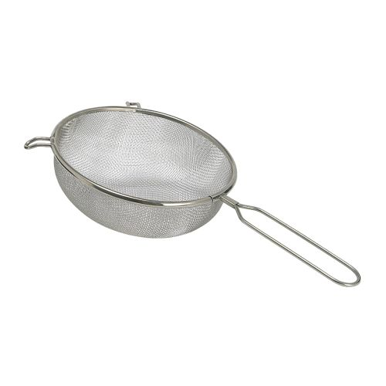
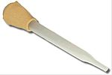
Other Preparation Tools
Would you know when to use it?
Tongs
Kitchen Forks
Ladles
Baster
Colander
Strainer
What is their purpose?
Could you recognize them from a picture?
Where do they go in the kitchen?

Slide 16
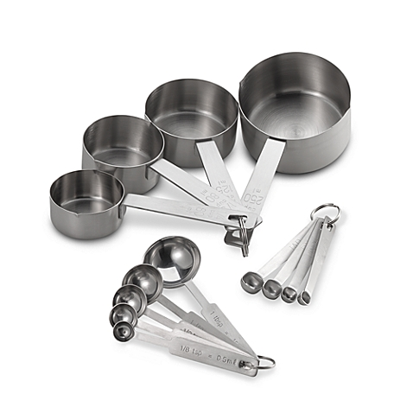
Wednesday, September 9th
Bell Ringer: Explain the three different types of Measuring Tools. Don’t forget to include the common sizes of each ☺
Reminder:
Potato Lab Monday
Test next Wednesday
Formal Lab next Friday

Slide 17
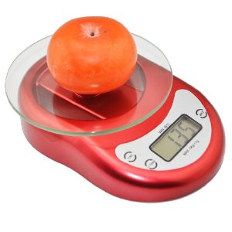
Agenda
Unit Abbreviations
Customary vs. Metric
Volume, Weight, Temperature, or Length
Worksheet – Mastering Measurement
Video – 10 min.
Measuring – Dry, Liquid, and Fats
Using a Scale
Affects of a sifter
Nevada Standard:

Slide 18
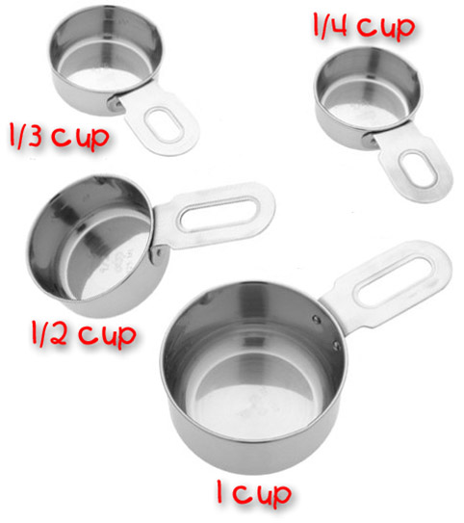
Colored Paper Activity
Write Name on one paper
Write abbreviation on other
Weight, Length, Temperature, or Volume
Metric / Customary

Slide 19
Mastering Measuring - Worksheet

Slide 20
Mastering Measuring Video
Learning Seed
Chapter on Kitchen Tools for Measuring Ingredients

Slide 21
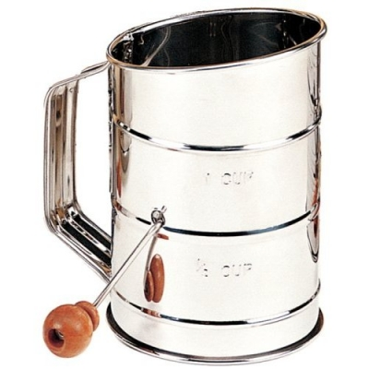
Measuring Dry Ingredients
Flour
½ cup
Weight of sifted vs. unsifted
Brown Sugar
¼ cup
Weight of packed vs. unpacked

Slide 22
Friday, September 11th, 2015
Bell Ringer: Write Sugar Cookie Recipe in your RECIPE portion of your composition book. Leave two columns to the left for halving and doubling ingredient amounts.
Reminder… take out your worksheet from last period and record the following conversions on it…
finish and turn in by end of class period Today ☺
8 oz. = 1 c. 16 oz. = 1 lb.

Slide 23
Agenda 5.2.1 – Identify the basic components of a recipe using different styles
Parts of a Recipe
Adjusting Recipes
Ingredient Substitutions

Slide 24
Parts of a recipe
Yield
Serving Size
Ingredients / Measurements
Directions
Nutritional Analysis

Slide 25
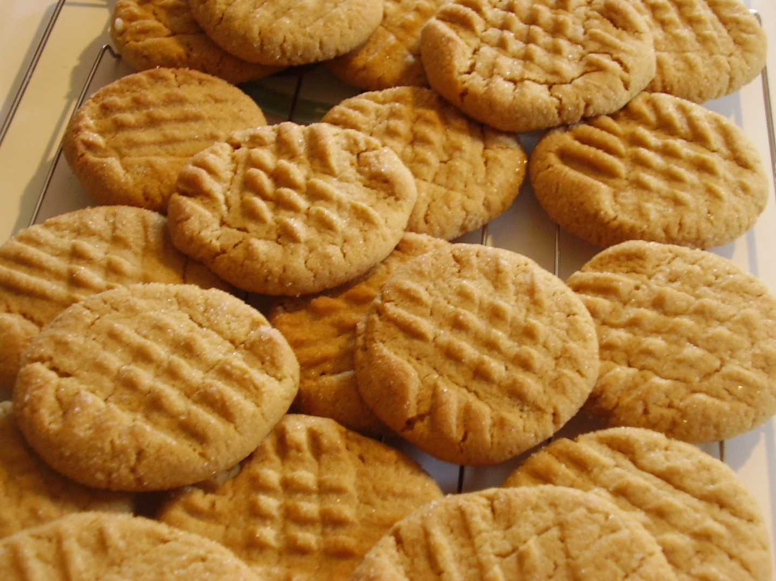
Adjusting Recipes
Importance of Yield
Consistency
Double Recipe Yield
Half Recipe Yield
Pg. 242 – common equivalent measures

Slide 26
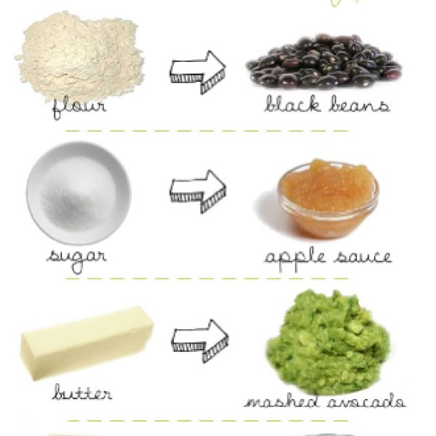
Ingredient Substitutions
Pg. 243 (substitute chart)
Make sure you have all ingredients before starting

Slide 27
Sugar Cookies
Yield – 48 cookies
Directions-
Combine flour, baking soda and baking powder.
In a separate bowl, CREAM sugar, vanilla extract, and butter.
Add egg and mix, then add flour mixture.
Preheat oven to 375 degrees F.. Bake for 10 min.
Ingredients-
2 ¾ c. all-purpose flour
1 tsp. baking soda
½ tsp. baking powder
1 ½ c. white sugar
1 tsp. vanilla extract
1 c. softened (not melted) butter
1 egg

Slide 28
Sugar Cookies
Yield – 48 cookies
Directions-
Combine flour, baking soda and baking powder.
In a separate bowl, CREAM sugar, vanilla extract, and butter.
Add egg and mix, then add flour mixture.
Preheat oven to 375 degrees F.. Bake for 10 min.
Ingredients-
2 ¾ c. all-purpose flour
1 tsp. baking soda
½ tsp. baking powder
1 ½ c. white sugar
1 tsp. vanilla extract
1 c. softened (not melted) butter
1 egg

Slide 29
Tuesday, September 15th
Bell Ringer: Cooking Methods… how many do you know? List and explain at least 5 different ways to cook an item (example… boiling) Are they dry, moist, or combination methods?
Reminder: Test next period. Nothing accepted from this unit after the test.

Slide 30
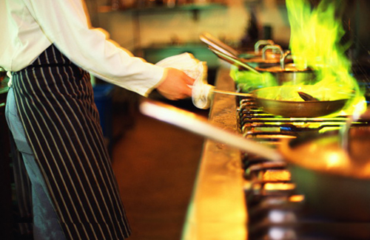
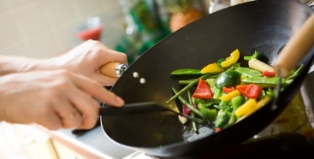
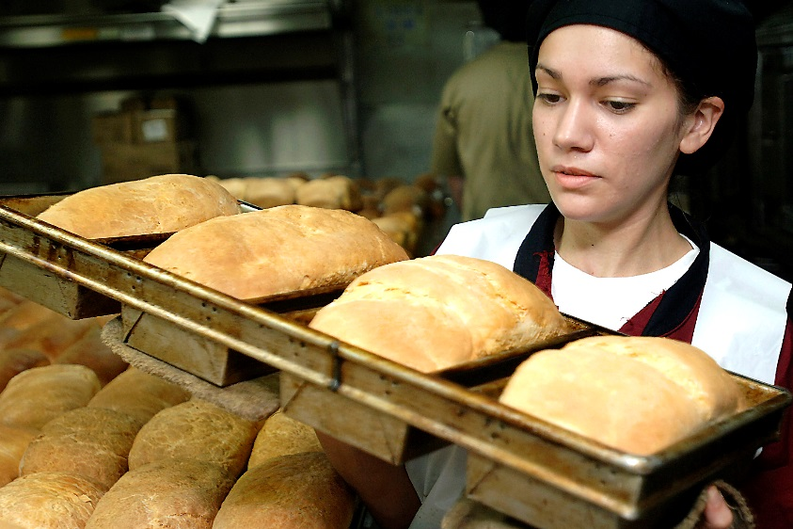
Agenda
Dry, Moist, and combination Cooking Methods
Practice each with a variety of labs
Buffet style eating

Slide 31
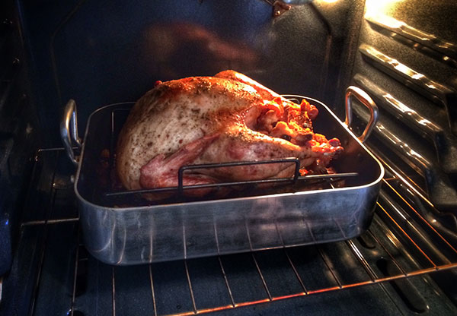
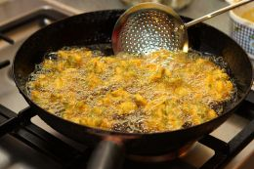
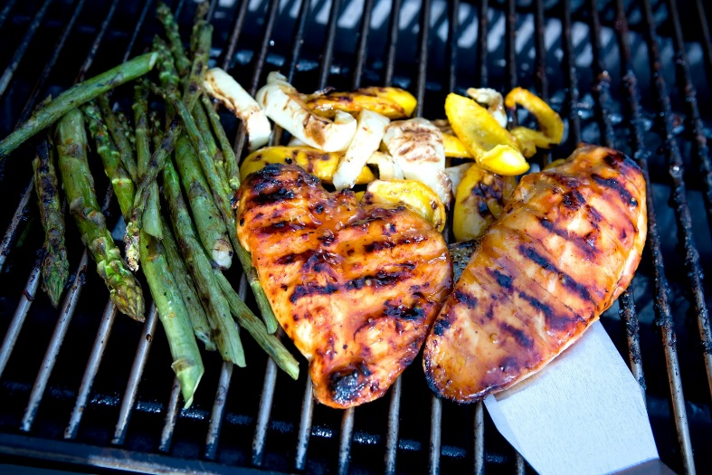
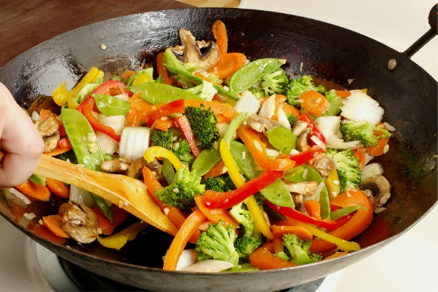
Dry Cooking Method
Food cooked with direct heat, like on a grill, or by indirect heat in a closed environment, like an oven
Without fat
With fat
Broiling
Grilling
Roasting
Baking
Sautéing
Pan-frying
Stir—frying
Deep-frying

Slide 32
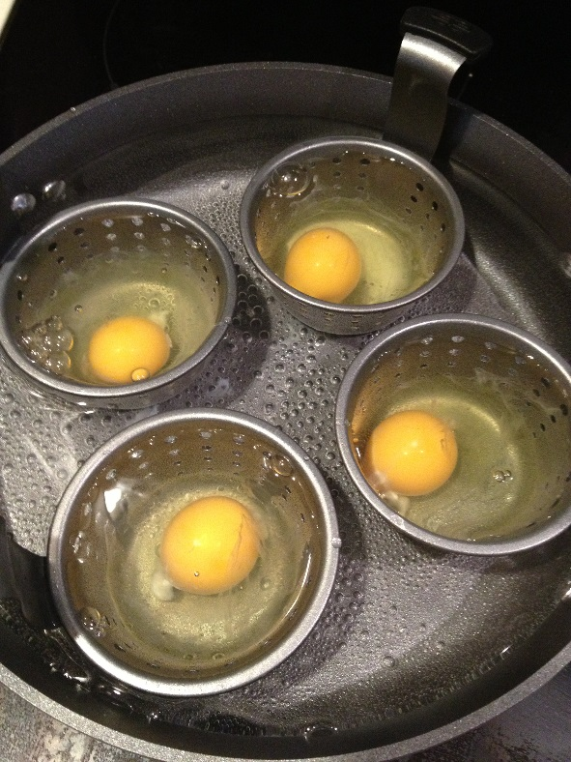
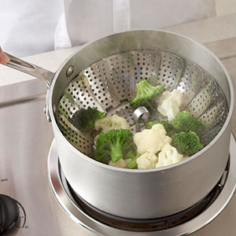
Moist Cooking Method
Produce food that is delicately flavored and moist, sometimes with a rich broth, which can be served as a separate course or used as a sauce base.
Simmering
Poaching
Blanching
Steaming

Slide 33
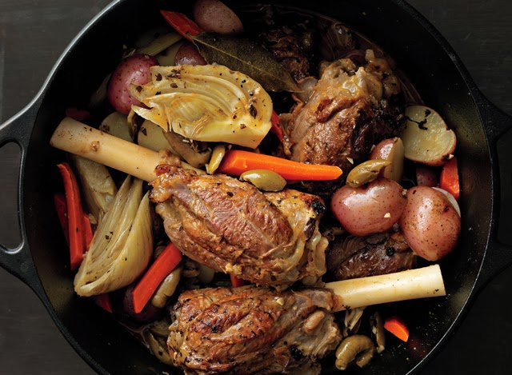
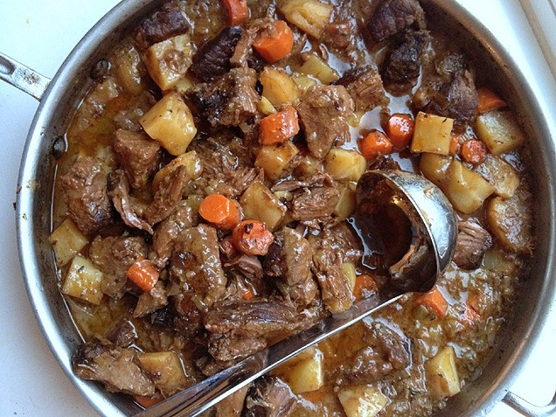
Combination Cooking Methods
Combines both dry and moist heat cooking methods
Braising
Stewing

Slide 34
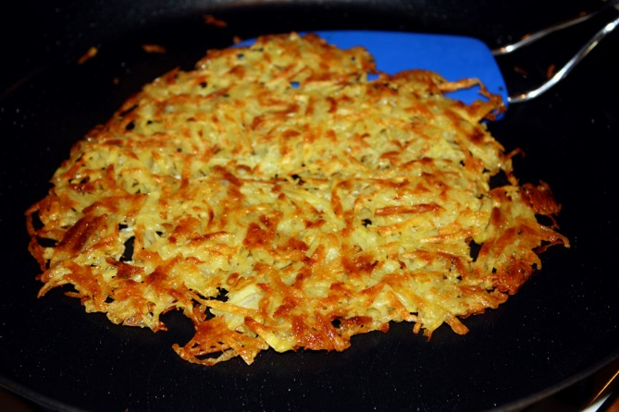
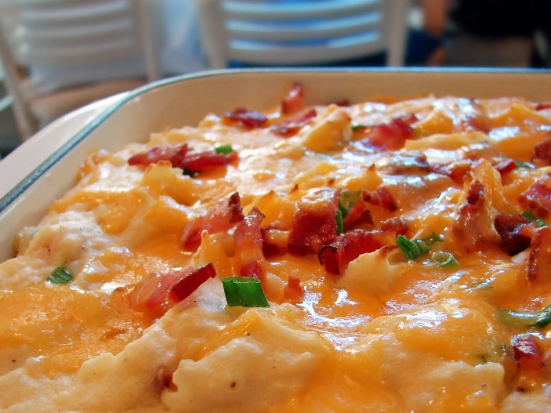
Let’s get in the kitchens to practice
Sweet Potato Casserole (cooks 30 min.) more challenging
Hash Browns (2 kitchens)
Lyonnaise Potatoes (advanced… more of a challenge)
Honey Roasted Red potatoes
Mashed potatoes
Sweet Potato chips
Buffet style eating at end

Slide 35
Thursday, September 17, 2015
Kitchen Resource Management Unit Test
Test TODAY!!!!!
Enter your favorite potato recipe from last class period in the recipe section of your book. Should be 5th recipe

