Slide 1
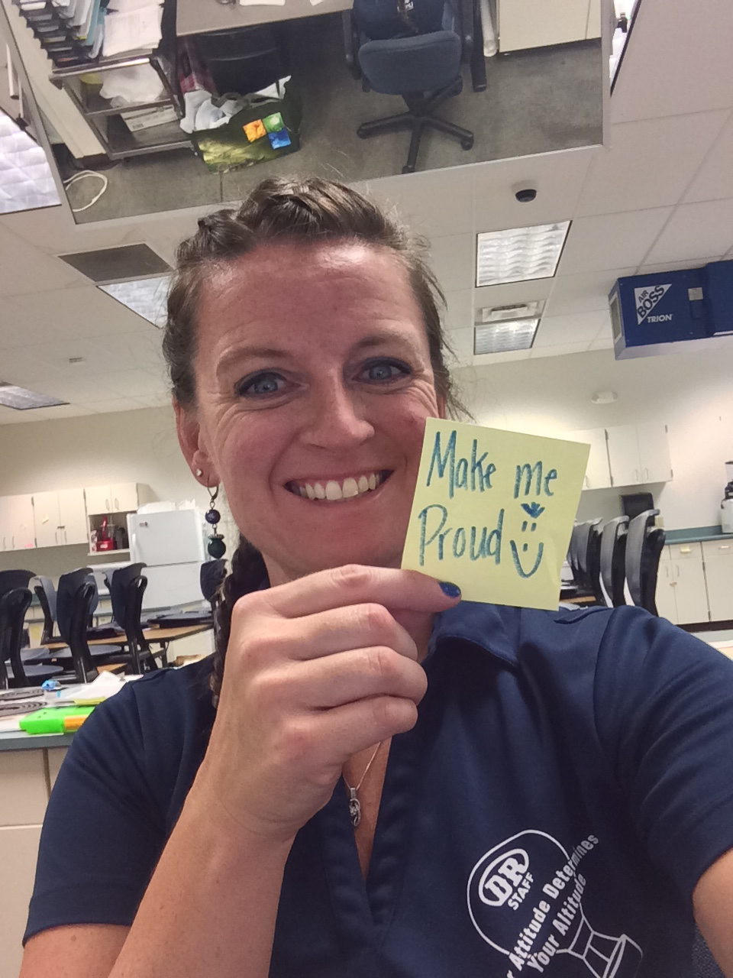
Tuesday, September 22nd
Bell Ringer: write the pancake recipe in your recipe portion of composition book. You will NOT be halving today ☺
Welcome: Mrs. Poore
Importance of Breakfast
Reminder… be on best behavior
Missed test??? You have until this Friday to make up

Slide 2
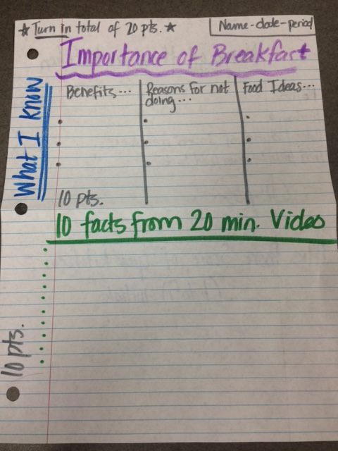
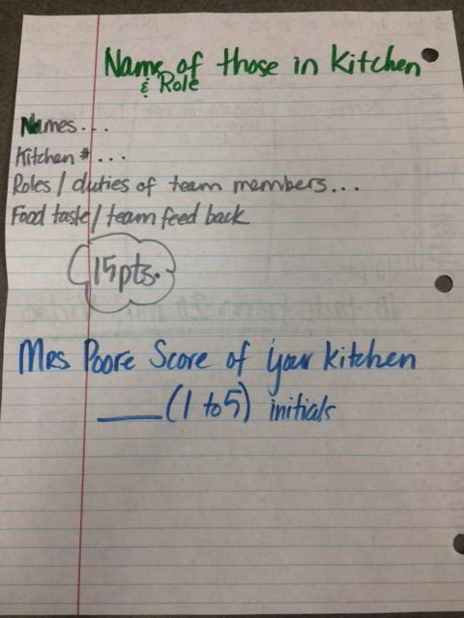
Turn in your paper … 20 points total Due to wicker basket at end of period
COOKING
Beginning of class
Be COMPLETE
Help Mrs. Poore get
these initialed

Slide 3
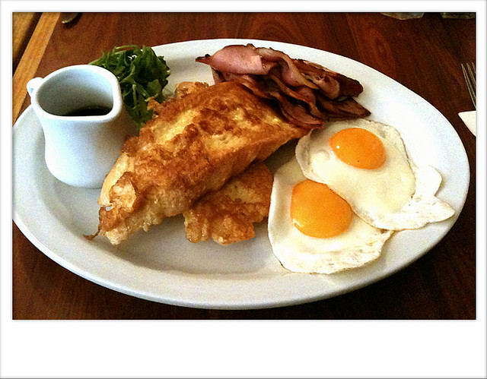
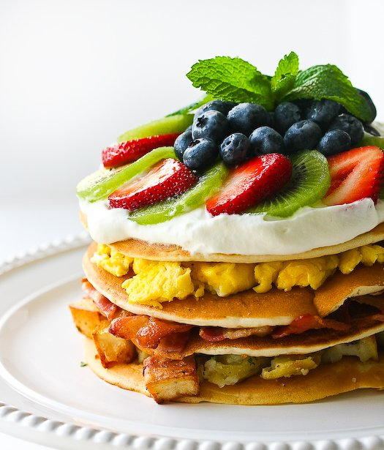
On Own piece of paper record what you know …
Benefits of eating a breakfast
Reasons why people don’t eat a breakfast
Some breakfast food ideas
5 minutes to record
Mrs. Poore shows you how to lay out your paper

Slide 4
Share ideas…
First with table group and then with class
Table needs to agree on …
1 Benefit
1 Reason
1 Food Idea
Each Table Report out your conclusion as a class
THINK
PAIR
SHARE

Slide 5
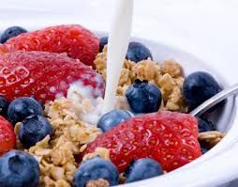
WATCH 20 MIN. VIDEO DVD – use computer ☺
Set notes section on same paper prior to watching video
Must record 10 complete thoughts explaining what you learned from the video
See Mrs. Thiede’s paper example for success ☺

Slide 6
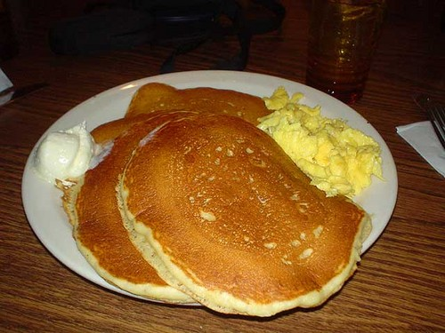
Make Breakfast ☺ Pancakes and Eggs
Original Kitchens (record information on your own paper… see Mrs. Thiede’s example)
No more than 5 per kitchen (4 is ideal)
Must be ready to eat 20 min. before bell rings (this leaves time to eat and clean up… figure your time management before cooking)
Use the griddles (found under microwave in kitchen 5) for your pancakes
Use a separate Teflon non stick frying pan for eggs (spray pan so they don’t stick)
Teamwork and time management are very important
Don’t leave kitchens messy!!!!!

Slide 7
Turn in your paper … 20 points total Due to wicker basket at end of period
COOKING
Beginning of class
Be COMPLETE
Help Mrs. Poore get
these initialed

Slide 8
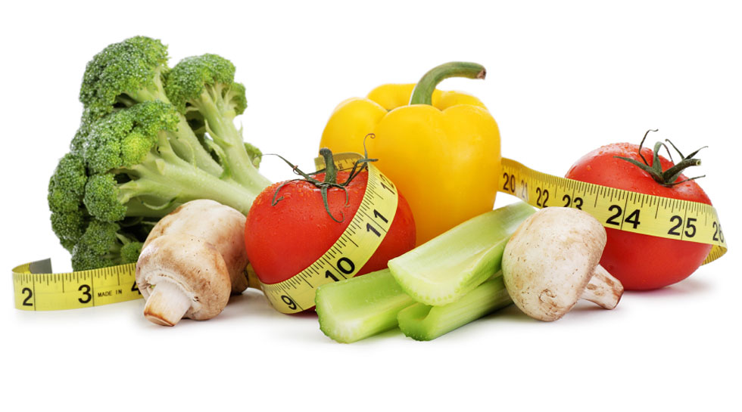
Thursday, September 24th
Why might people not eat the foods they need for good nutrition?
Define Nutrition and Malnutrition (pg. 34)
Chapter 2
3.1 – Explore the Effect of Nutrients of the Human Body
3.1.2 – Outline the 6 basic nutrient groups, the individual nutrients, their sources and their roles

Slide 9
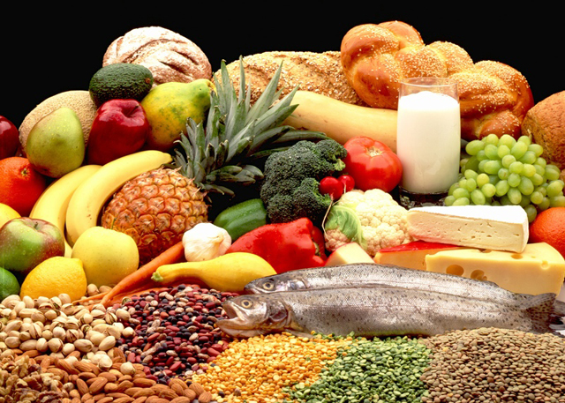
What are the 6 nutrients?
Carbohydrates
Fats
Proteins
Vitamins
Minerals
Water

Slide 10
What you need to know…
Sources
Role in our Body
Result of deficiencies
Result of excess
Important facts – subcategories
Simple vs. Complex Carbohydrates
Saturated vs. Unsaturated Fats
Water vs. Fat Soluble Vitamins
Complete vs. Incomplete proteins

Slide 11
Grade for poster / presentation
POSTER
PRESENATION
FOOD SOURCES
Role / Function in our Body
Result of deficiencies
Result of excess
Key facts
ORGANIZATION / NEATNESS / QUALITY
30 POINTS
CONFIDENCE (POSTURE – EYE CONTACT)
KNOWLEDGE OF SUBJECT
VOICE (VOLUME AND SPEED)
TEAMWORK (ALL MEMBERS PRESENT)
COVERED ALL MATERIAL
25 POINTS
Names: ________________________________________________
Date: _______________________ Period: ____________________
Topic: __________________________________________________

Slide 12
VITAMINS (A, D, E, AND K) | MINERALS - CALCIUM
WATER | FATS (CHOLESTEROL)
CARBOHYDRATES (STARCHES, SUGARS, AND FIBER) | PROTEIN
VITAMIN C, THIAMIN, RIBOFLAVIN | NIACIN, VITAMIN B6, FOLATE
VITAMIN B12, PANTOTHENIC ACID, BIOTIN | PHOSPHORUS, MAGNESIUM, SODIUM, CHLORIDE, AND POTASSIUM
TRACE ELEMENTS (IRON, ZINC, IODINE, AND FLUORIDE)

Slide 13
Monday, September 28th
Bell Ringer: Get poster and review / organize your lesson to teach your peers about your chosen nutrient. We will begin presentations 10 min. after bell rings.
Video
Reminder: you will need to turn in your grade sheet before you teach

Slide 14
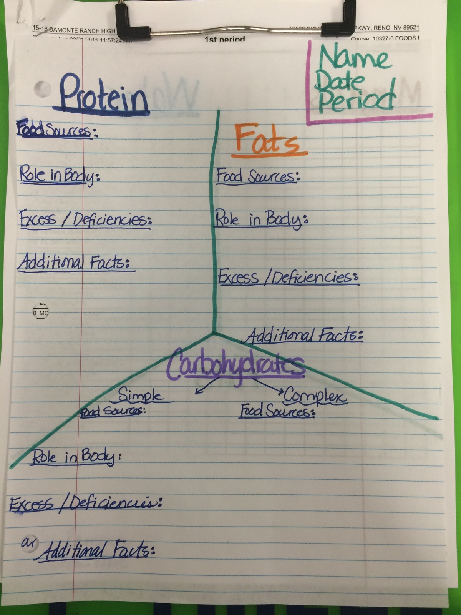
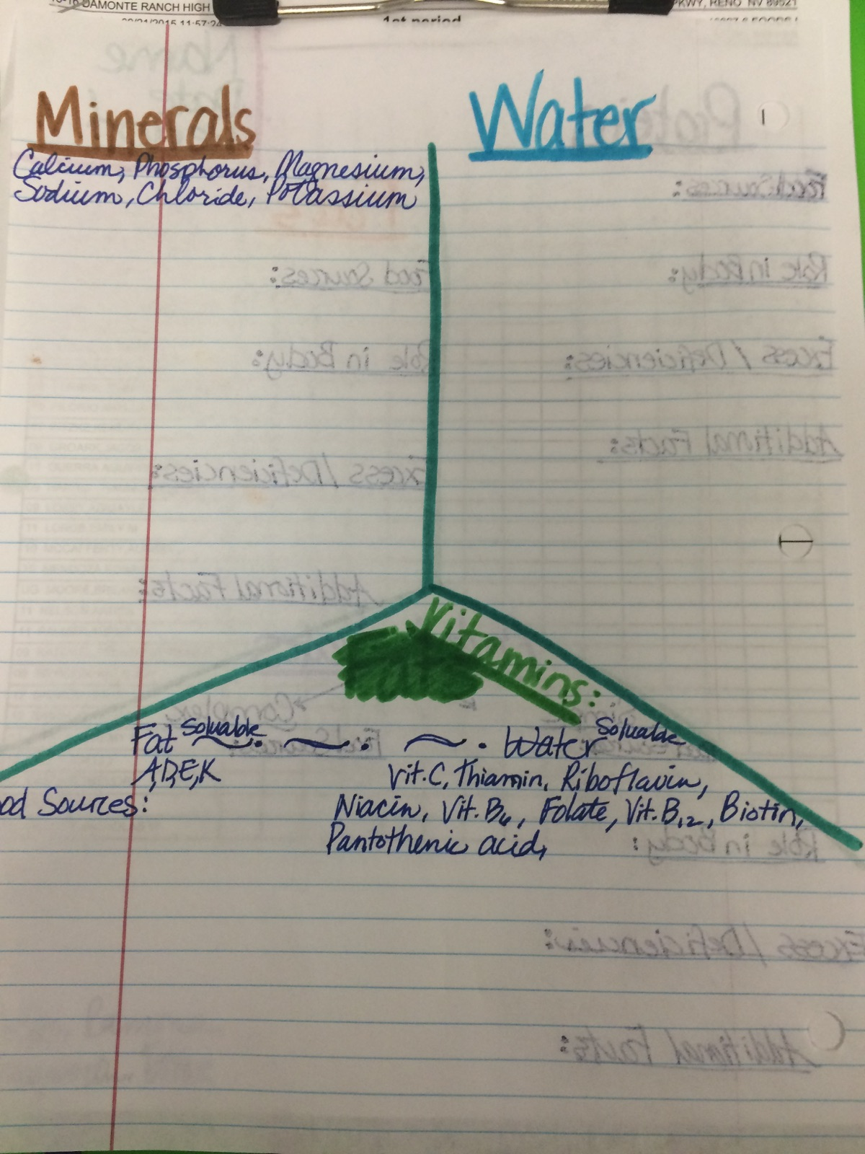
30 points
Study for quiz next period

Slide 15
Time for you to TEACH ☺ Take notes from presentations
PRESENATION
CONFIDENCE (POSTURE – EYE CONTACT)
KNOWLEDGE OF SUBJECT
VOICE (VOLUME AND SPEED)
TEAMWORK (ALL MEMBERS PRESENT)
COVERED ALL MATERIAL
25 POINTS

Slide 16
video
Don’t forget to turn in your nutritional needs worksheet next period… study it so you are familiar with the functions and food sources.

Slide 17
Wednesday, September 30th
Bell Ringer: Copy Chicken Fried Rice Recipe in composition book. Is this recipe #8?
Collecting Comp. Books for Recipe
grades next class period ☺
50 points possible

Slide 18
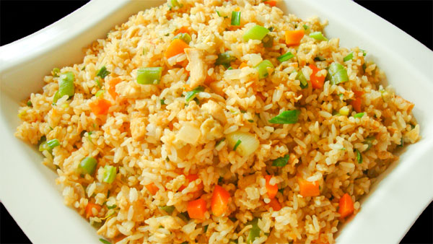
AGENDA:
Chicken Fried Rice
On own paper…
Names of kitchen members (1)
Kitchen number (1)
Lab name (1)
Nutrition Analysis (5)
Evaluation of food / lab / teamwork (5)
Sanitation / Cleanliness (5)
Final Product (2)
20 points

Slide 19
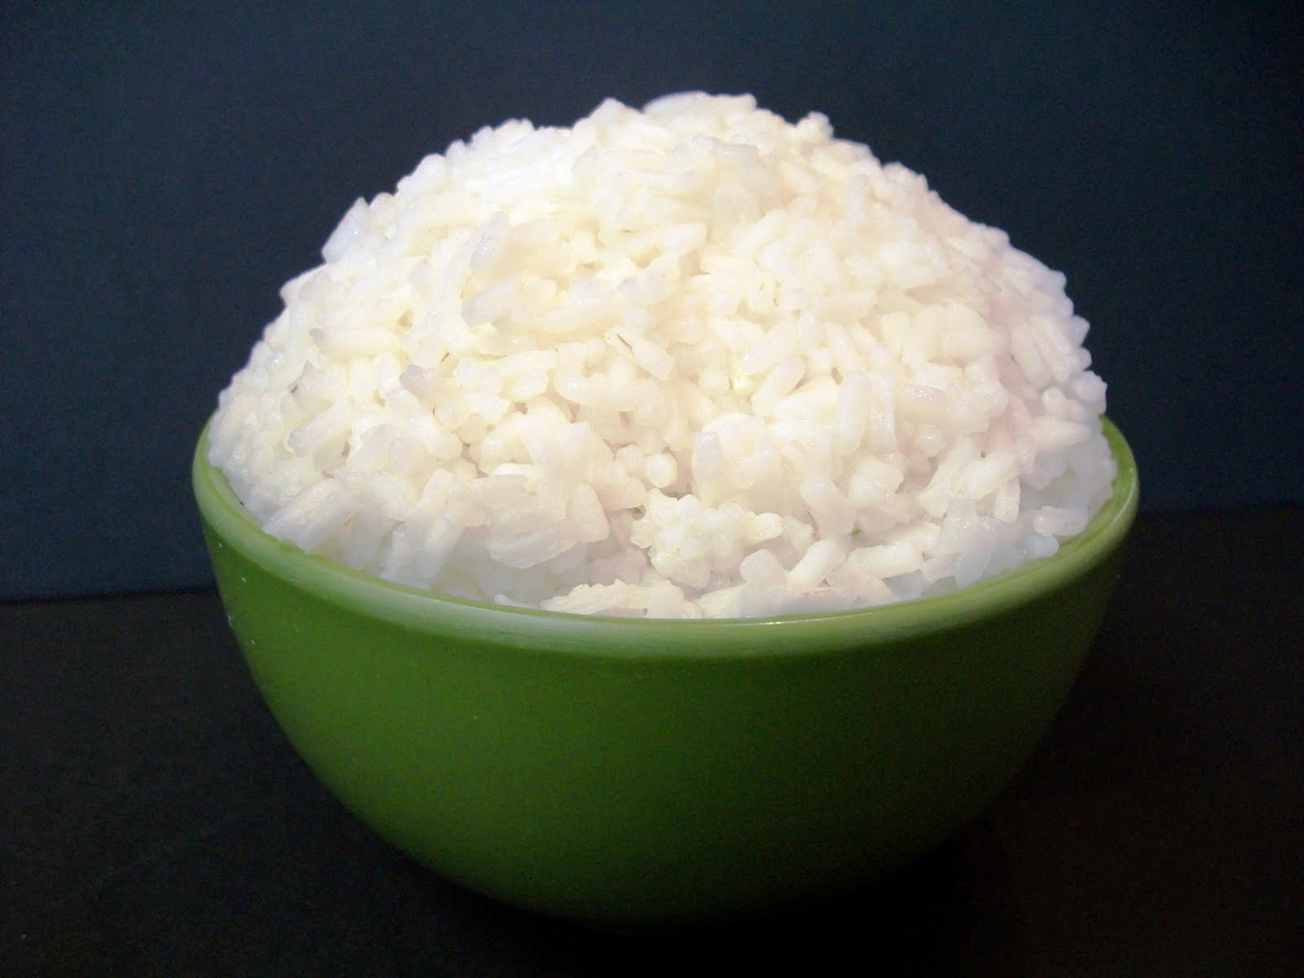
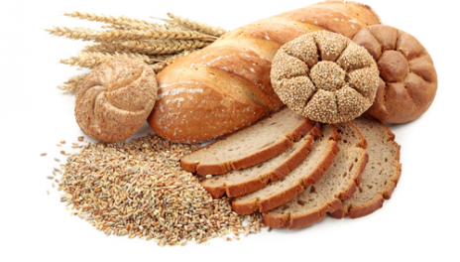
Rice nutritional Guide

Slide 20
Friday, October 2nd
Bell Ringer: What are the different stages of a human life cycle and how does the diet differ in each? (chapter 4 – pg. 80)
Reminder: turn in recipe book (8) and yellow nutrition paper
3.2 – Examine the Nutritional Needs of Individuals and Families Throughout the Life Cycle

Slide 21
AGENDA:
Wrap up Nutritional Analysis and Lab Evaluation from last class period. (15 min.)
Introduce 8 stages throughout the human life cycle
Discuss nutritional needs at each stage

Slide 22
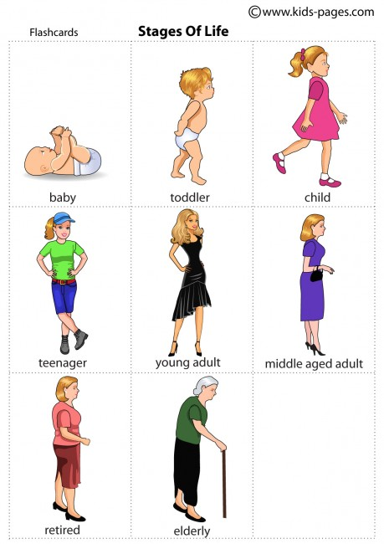
8 Different Stages of Life Cycle
Pregnancy
Lactation
Infancy
Early Childhood
Elementary School Years
Teen Years
Adulthood
Later Years

Slide 23
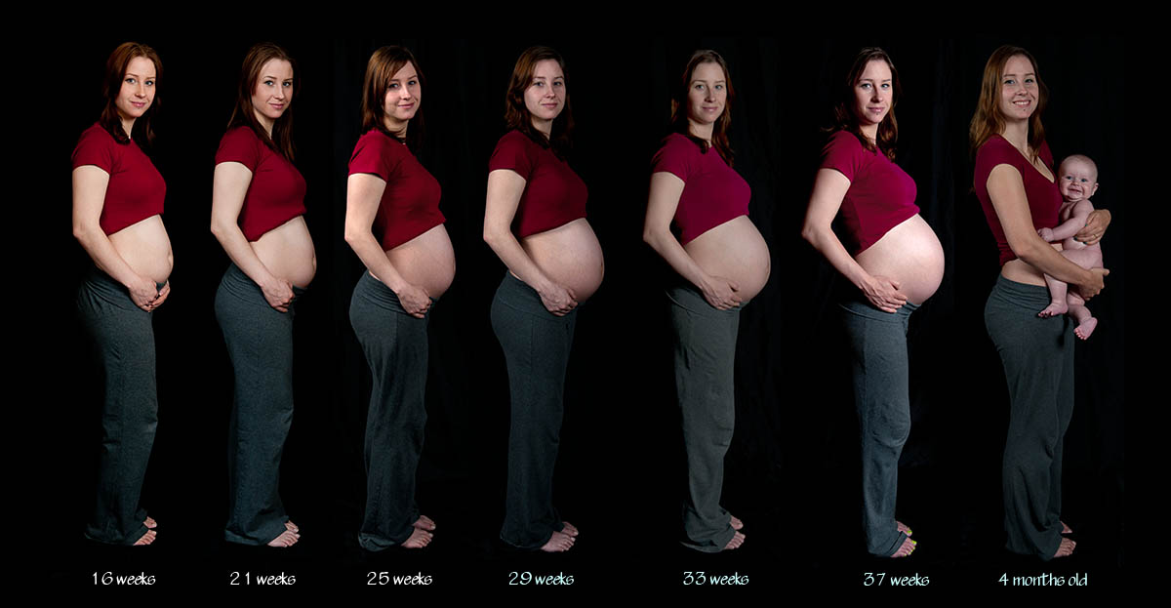
Pregnancy (video)
First Trimester:
Folate (prevents neural tube damage)
Second Trimester:
Increase all six nutrients
Protein, Iron, and Calcium very important
Limit solid fats and sugars
Increase Calories up to 300 per day
Avoid drugs
Alcohol, tobacco, and illegal drugs
Gets to baby through the placenta
Healthy weight gain
25-35 lbs.

Slide 24
Lactation: (production of breast milk)
Increased energy, protein, mineral, and vitamins
2-3 quarts of water / day
Extra grains, vegetables, and meat
Avoid drugs
Alcohol, tobacco, and illegal drugs
Prescription and over the counter (ask Dr.)
Pass to baby via breastmilk

Slide 25
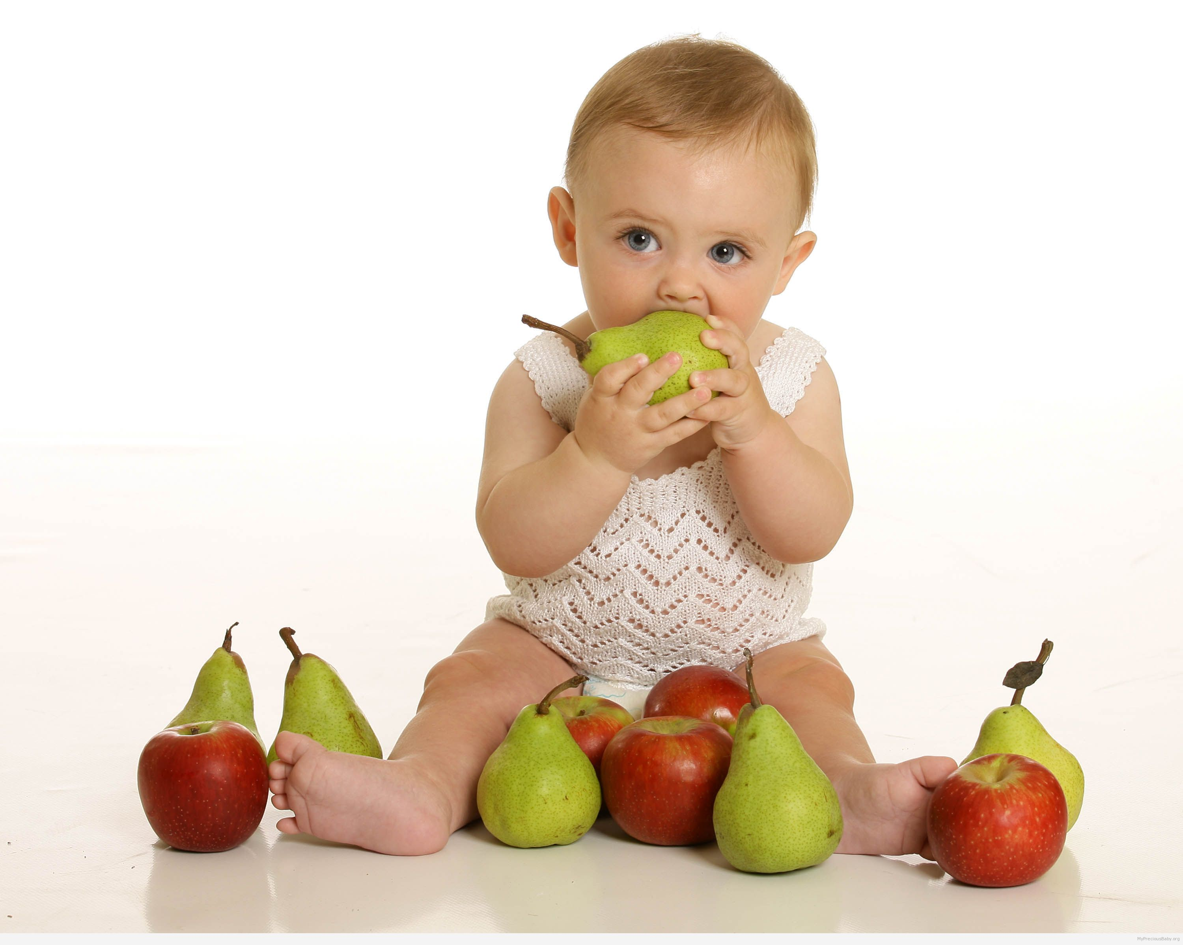
Infants: A healthful diet is more important during the first year of life than at any other time in the life cycle.
Nutrient requirements are higher per unit of body weight than an adult
Iron – not found in breast milk (formula fortified but not easily absorbed)
Vitamin K (at birth)
Vitamin D prevents Rickets
Rate of growth fastest first 2 months of life
By age one weight typically triples
Length 1 ½ times birth

Slide 26
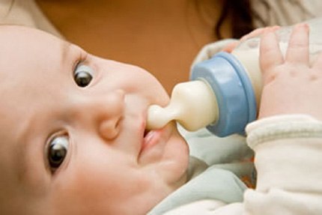
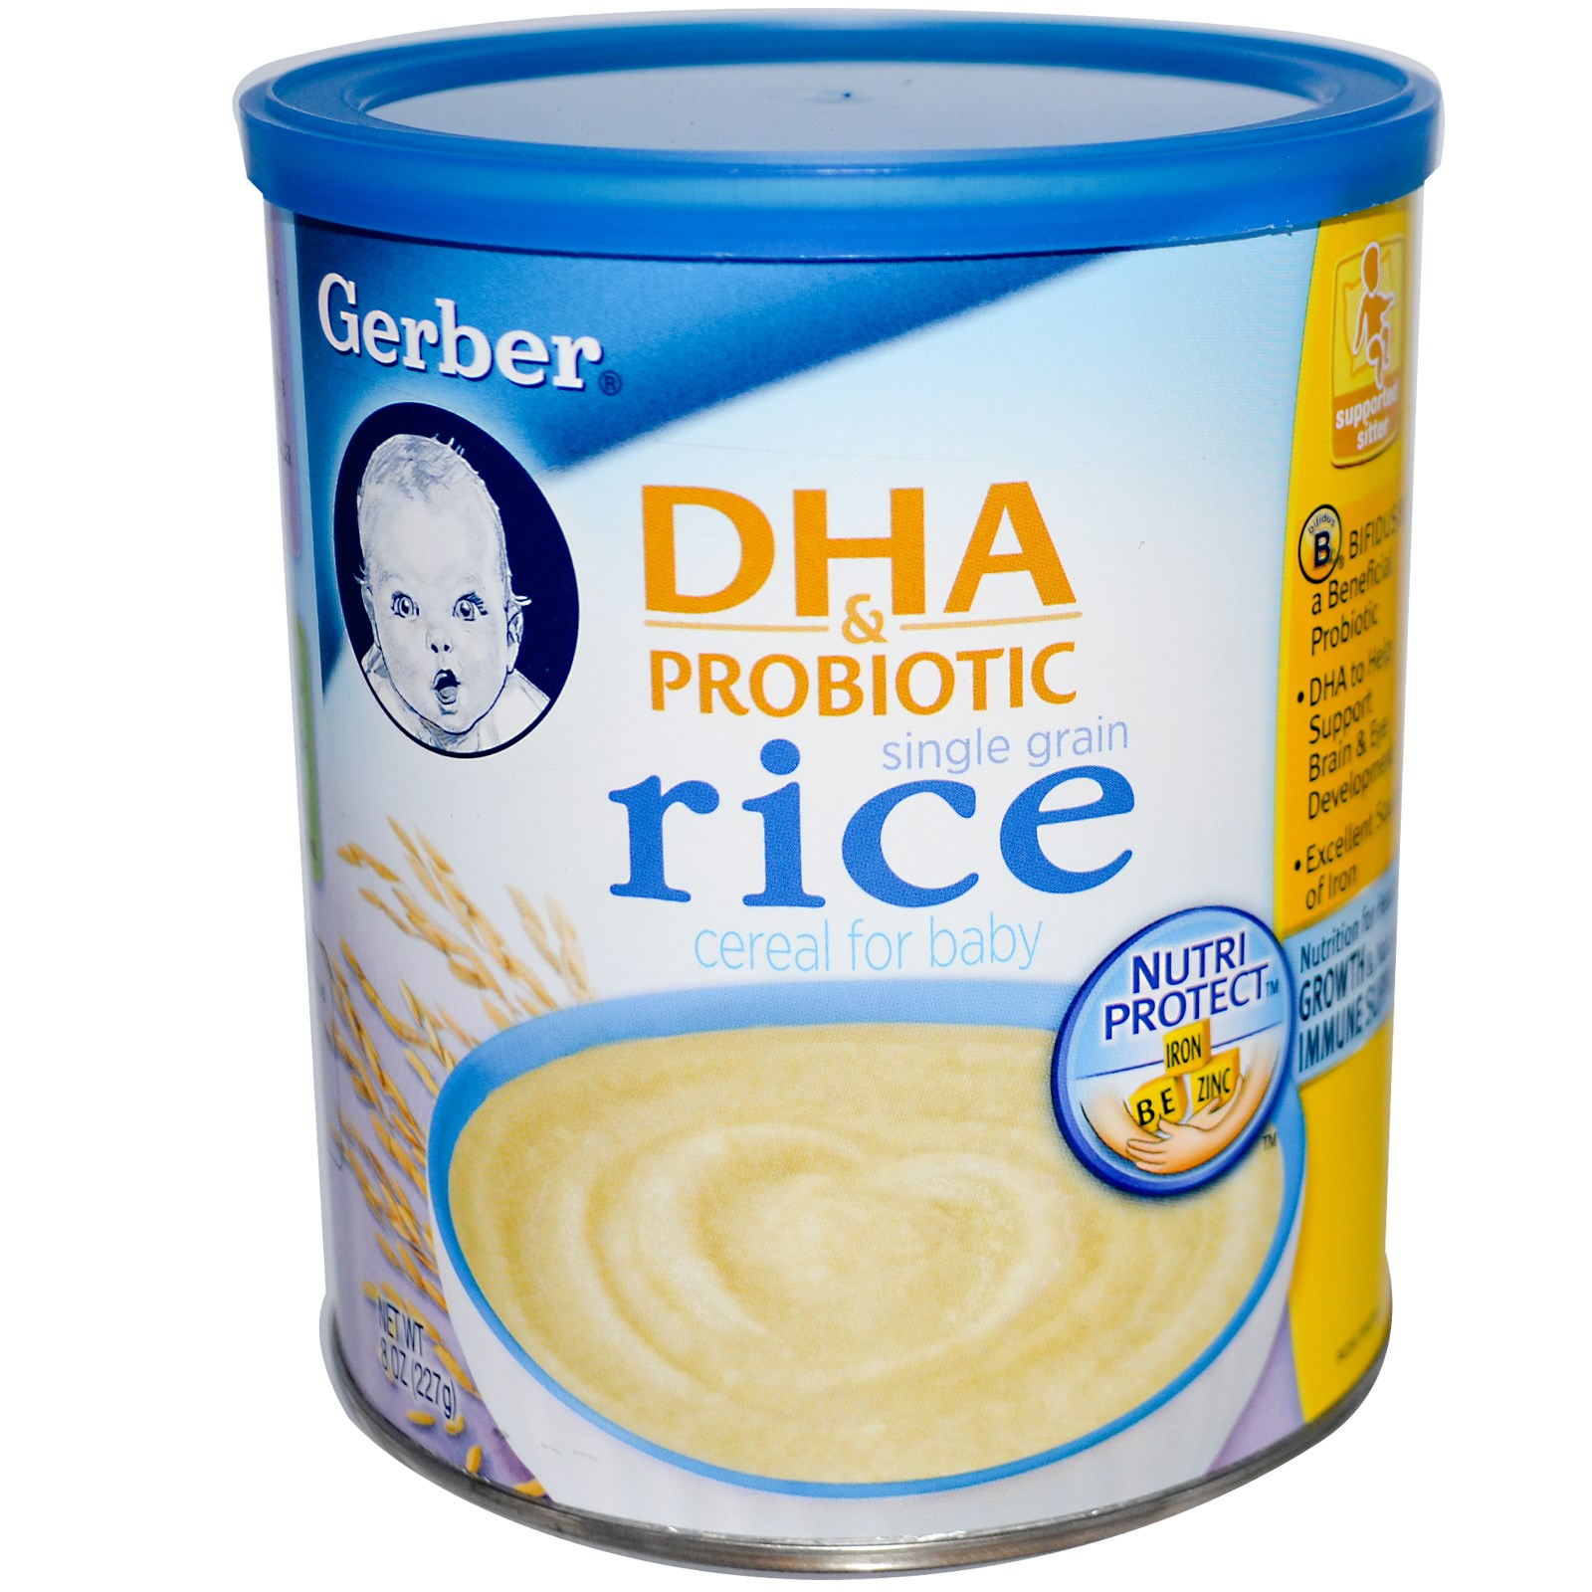
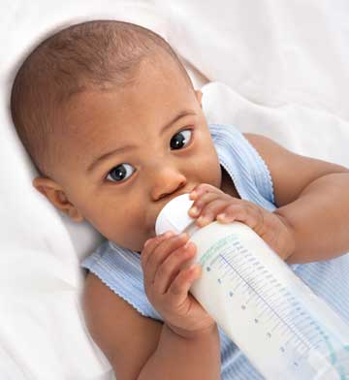
Feeding Infants :
Fed 7-8 times / day
Breast milk recommended
Brain development
Easier to digest
Provides nutrients
Immune system
Helps prevent allergies
Cow milk introduced after age 1
4-6 months old introduce solid foods
Single grain fortified iron cereal

Slide 27
Preschool Children

Slide 28
Tuesday, October 6th
Bell Ringer:
Write 5 guidelines you think would be found in the USDA Dietary Guidelines for our Nation.
USDA Dietary Guidelines – 2010
Home made Applesauce
3.3 – Assess the Impact of Individual Food Choices in Relation to Health Promotion and Disease Prevention

Slide 29
Thursday, October 8th
Bell Ringer: Record Eggplant Parmesan recipe in your composition book (must be done before cooking!!!!)
Irigoyen Farms - California
REMINDER: Composition books (bell ringers turned in next period) should have 11 currently

Slide 30
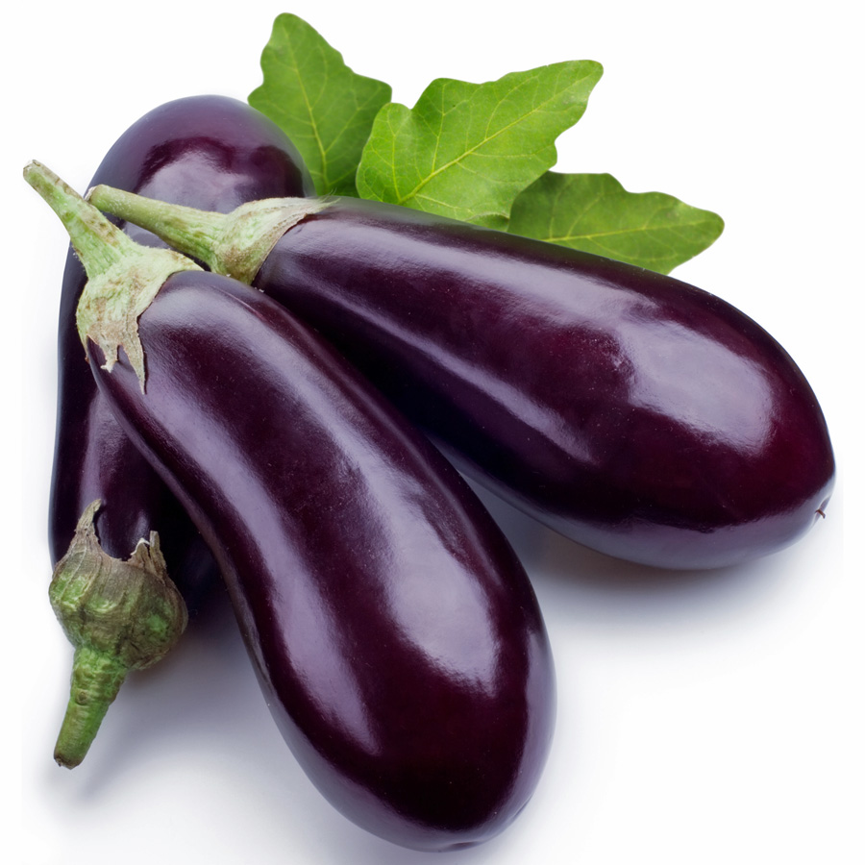
AGENDA:
Write Recipe
Watch recipe video
Make eggplant parmesan
Be prepared to discuss the nutritional value of dish

Slide 31
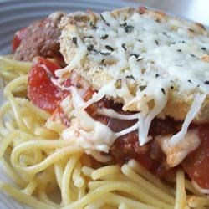
Eggplant Parmesan II
Prep
25 m
Cook
35 m
Ready In
1 h
Recipe By:Dolores Gentner-Ryan
"This is a no fry variation of this popular dish, and is just as delicious!"
Ingredients
3 eggplant, peeled and thinly sliced
2 eggs, beaten
4 cups Italian seasoned bread crumbs
6 cups spaghetti sauce, divided
1 (16 ounce) package mozzarella cheese, shredded and divided
1/2 cup grated Parmesan cheese, divided
1/2 teaspoon dried basil
Directions
Preheat oven to 350 degrees F (175 degrees C).
Dip eggplant slices in egg, then in bread crumbs. Place in a single layer on a baking sheet. Bake in preheated oven for 5 minutes on each side.
In a 9x13 inch baking dish spread spaghetti sauce to cover the bottom. Place a layer of eggplant slices in the sauce. Sprinkle with mozzarella and Parmesan cheeses. Repeat with remaining ingredients, ending with the cheeses. Sprinkle basil on top.
Bake in preheated oven for 35 minutes, or until golden brown.
ALL RIGHTS RESERVED © 2015 Allrecipes.com

Slide 32
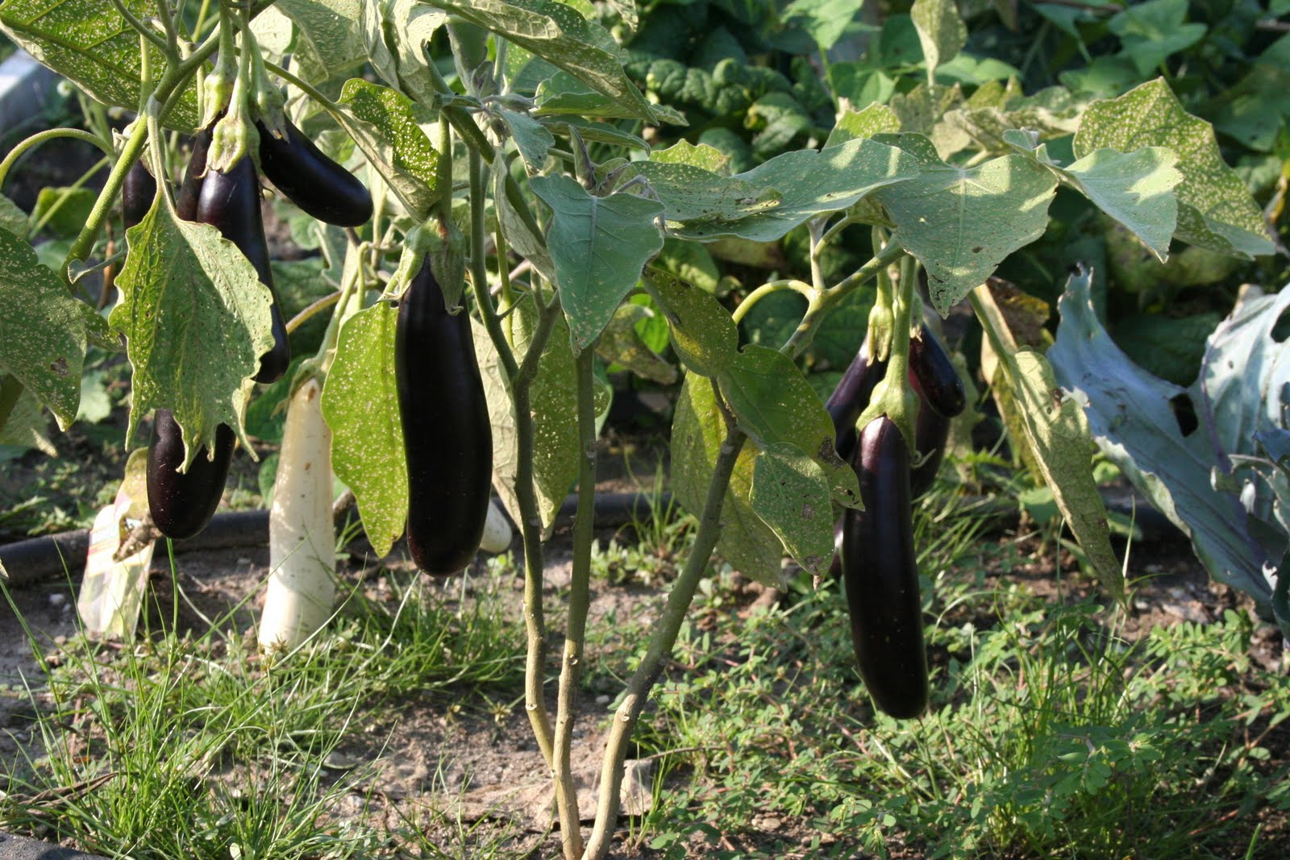
Nutritional Value of Eggplant
Amount Per 1 cup, cubes (82 g)
Calories 20
% Daily Value*
Total Fat 0.2 g | 0%
Saturated fat 0 g | 0%
Polyunsaturated fat 0.1 g
Monounsaturated fat 0 g
Cholesterol 0 mg | 0%
Sodium 2 mg | 0%
Potassium 188 mg | 5%
Total Carbohydrate 4.8 g | 1%
Dietary fiber 2.5 g | 10%
Sugar 2.9 g
Protein 0.8 g | 1%
Vitamin A | 0% | Vitamin C | 3%
Calcium | 0% | Iron | 1%
Vitamin D | 0% | Vitamin B-6 | 5%
Vitamin B-12 | 0% | Magnesium | 2%

Slide 33
Monday, October 12th
3.4 – Understand Nutritional Management Procedures Related to Health Conditions

Slide 34
Wednesday, October 14th
3 HOUR DELAY PSAT – All Sophomores and paid juniors

Slide 35
Friday, October 16th
Test Day ☺ Make sure you are paying attention in class so you can succeed on the

