Slide 1
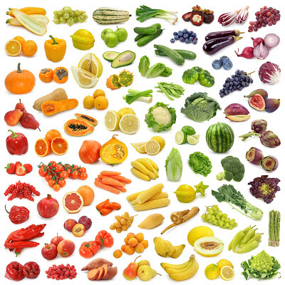
Welcome to Foods and Nutrition ☺
Mrs. Thiede (TD)
Tuesday, August 11th
Find a comfortable seat next
to someone you have never met. Be prepared to introduce and share one interesting thing about your new friend ☺

Slide 2
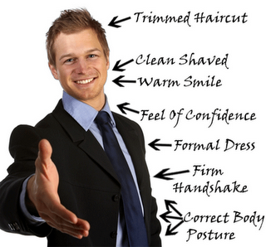


Slide 3

What to expect in this class…
Topics
Class Environment

Slide 4

Analyze Career Pathways & Employ Industry Professional Standards
Food Choices
Entrepreneurship & Professional Practices
Nutrition
Meal Management
Consumerism
Kitchen Resource Management
Food Selection & Preparation
Sanitation & Safety

Slide 5
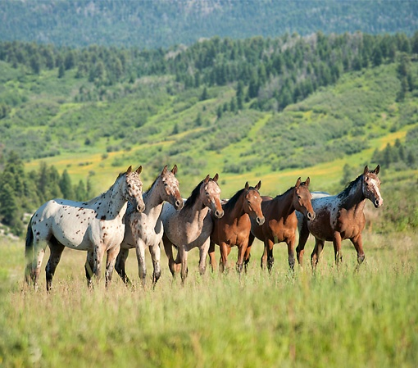
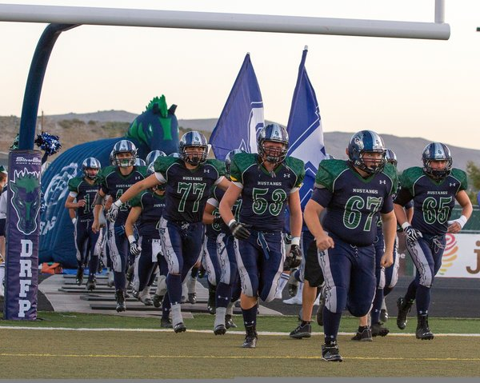
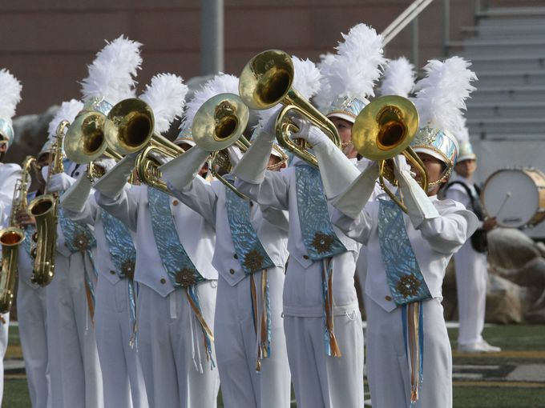
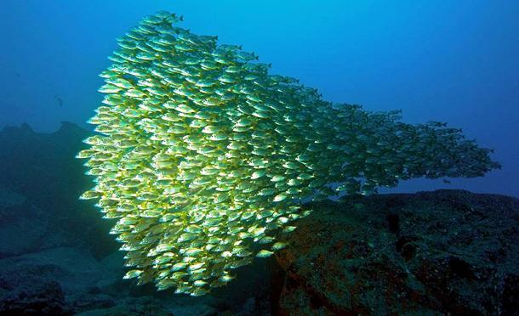


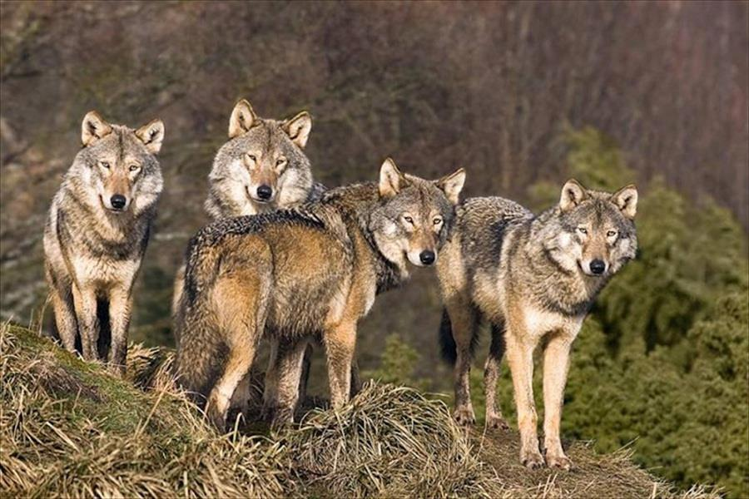
TEAMWORK
Tator Tot Thiede

Slide 6

Your Misson…
Syllabus signed
(next period)
Lab Fee???
(due by September 1st)
Composition Book
(due by 17th/18th)

Slide 7

Thursday, August 13th
Be prepared to share with the class the following answer and explanation.
What is your favorite food choice and why?
Randomly call on you using popsicle sticks.
Do you have your syllabus?
Did you pay your $25/semester lab fee?
Need a composition book by next week

Slide 8
AGENDA
Class Website
General Lab Safety / Expectations
  “Uniform”
  Hand washing
  Cleanliness and organization of kitchens
  Using Stove / Oven (electric)
  TEAMWORK
  Time management
Distribute Recipes…
  Routine – write in composition book
  Discuss as team roles in kitchen

Slide 9
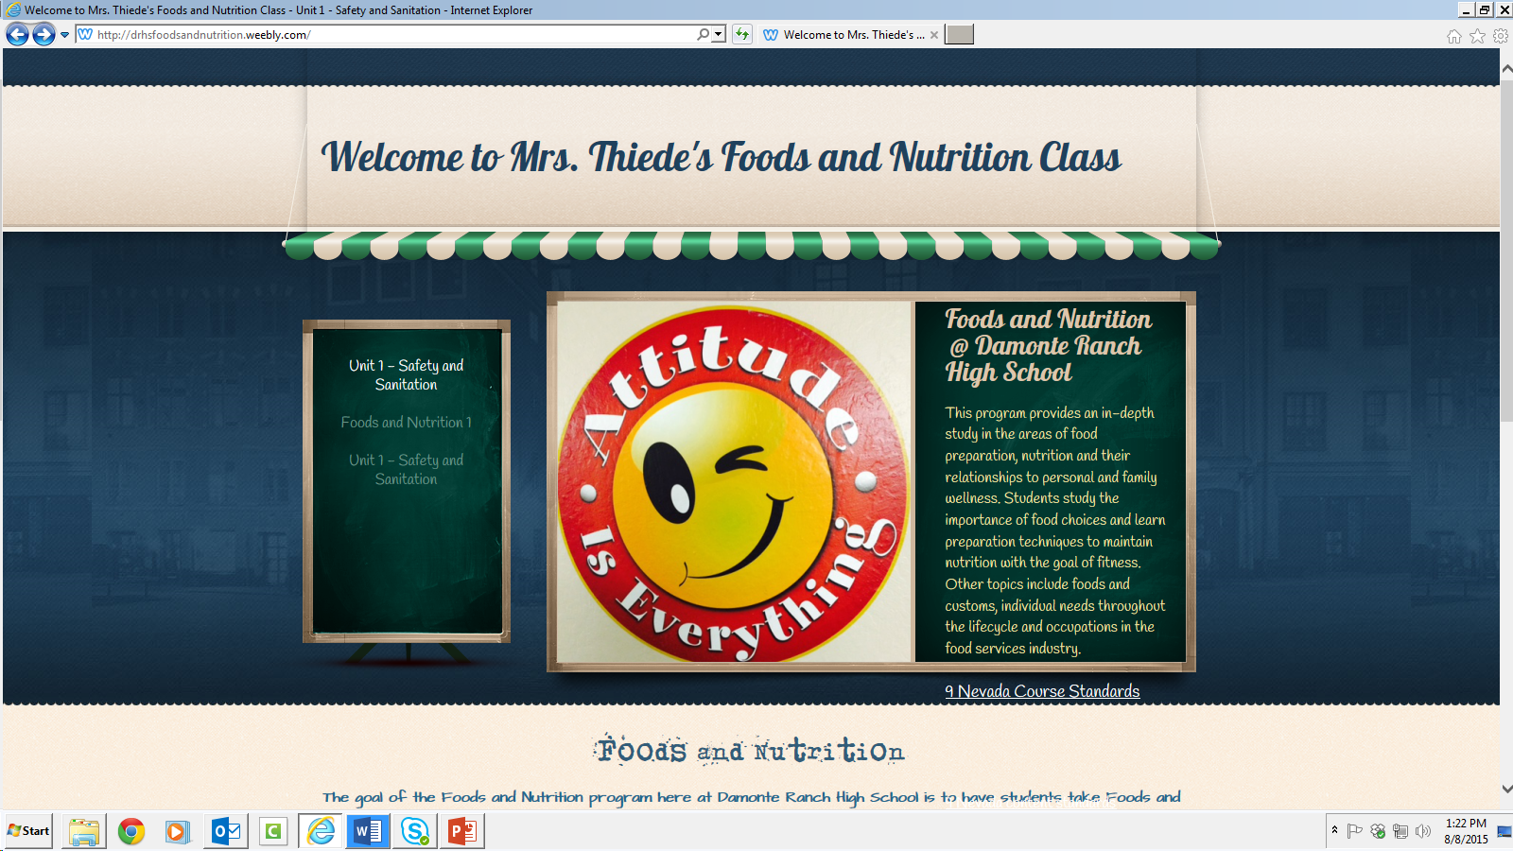
Class Website

Slide 10

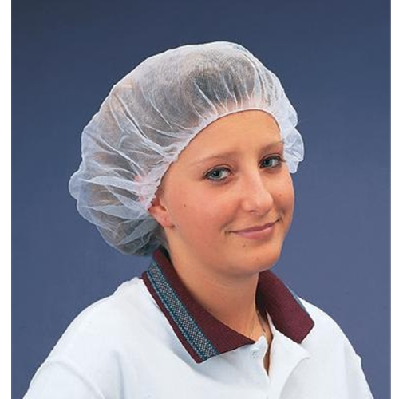
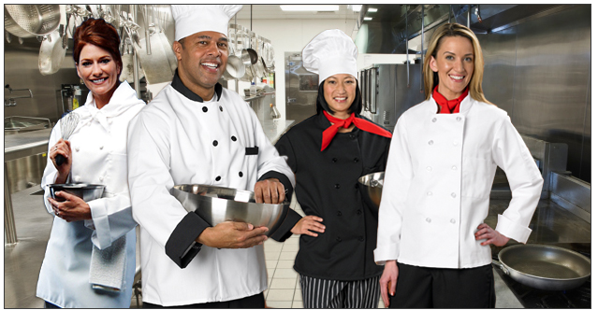

Lab Uniform
Closed toed shoes
Hair up (rubber band, hat, net)
Apron / jacket
No long baggy clothes
No rings / bracelets

Slide 11
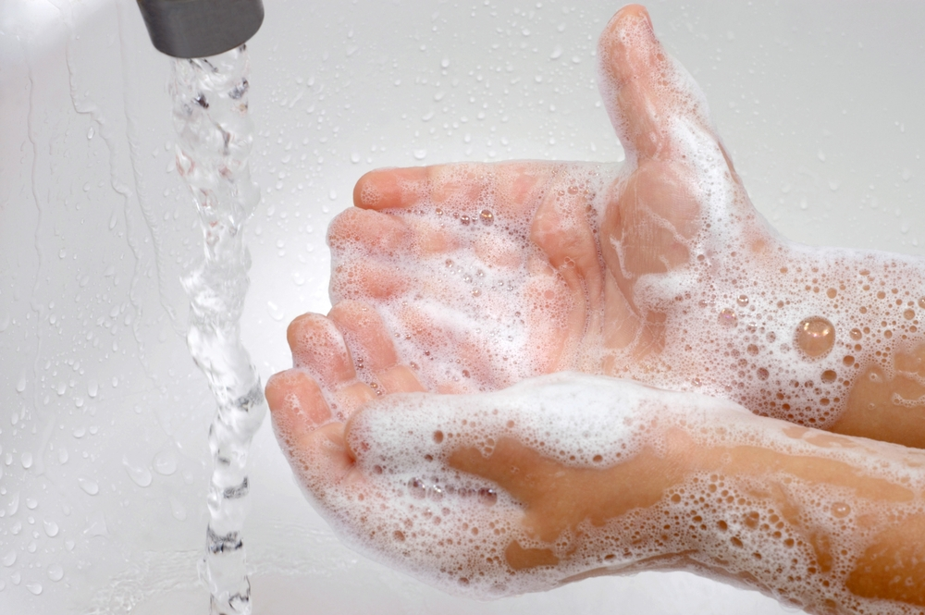
Hand washing
How long should you wash your hands for?
What should the temperature of the water be?
Biggest step to prevent transmission of harmful bacteria.
Done after sneezing, coughing, using the toilet, or touching your face, hair, or any unsanitary object
Fingernails
Paper towel only for drying hands… NOT DISHES

Slide 12
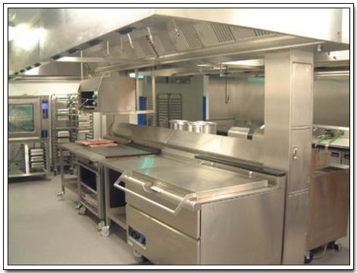
Cleanliness & Organization of Kitchens
Everything has a place
Labeled
Have Pride
Clean dishes completely as a TEAM
Don’t forget the floor
Wash rag and 2 dish towels to go under sink
Don’t forget the sink

Slide 13

Teamwork and Time Management
Rotate jobs
Help each other out
Self manage
EVERYONE works until entire job complete
Plan of attack before you start
  Who does what role?
  Set dead lines for different jobs/duties

Slide 14

Recipe Routines
Distribute Recipes…
  Routine – write in composition book
    Take picture if you don’t have book today (H.W.)
  Discuss as team roles in kitchen
  Chia and flax seeds

Slide 15
Benefits of Chia Seeds
    Increases energy levels
    Increases endurance levels
    Helps with weight loss
    Normalises blood sugar levels
    Cleanses the colon
    Gets rid of the toxins
    Prolongs hydration
    Reduce inflammation
    Helps tone muscles
    Helps to lower the blood pressure
    Improves mental performance
    Improves night rest and mood
    Lowers the risk of heart diseases
    Improves overall health
    Lowers cholesterol
    Absorbs extra acid, helping to get rid of acid reflux
    Helps thyroid conditions
    Helps IBS
    Helps celiac disease
1. Flaxseeds are a a great source of fiber and work as a natural laxative. They are a great way to keep things regular.
2. Flaxseed oil contains concentrated amounts of alpha-linolenic acid (ALA), an omega-3 fat. Vegetarians and vegans often use this as a substitute for fish oil, although there are differing opinions over whether the Omega-3 in flaxseed oil is as beneficial as that in fish oil.
3. Ground flaxseed has been shown to work just as well as statins in lowering cholesterol.
4. Flaxseeds are a good source of magnesium.
5. Flaxseeds contain high levels of lignans. Lignans may protect against estrogen-dependents cancers such as breast cancer.
6. An ounce of ground flaxseed per day was shown to regulate estrogen levels in post-menopausal women.
7. Flaxseeds have been shown to protect post-menopausal women from heart disease.
8. Flaxseed decreases insulin resistance and may protect against diabetes.
9. Preliminary research in mice shows that flaxseeds may prevent or slow the spread of prostate cancer.
10. Studies in mice show that flaxseed may prevent or slow the spread of melanoma.

Slide 16
Your Mission…
Record Recipe in Composition Book
Lab Fee???
(due by September 1st)
Composition Book
(due by 17th/18th)

Slide 17


Monday, aug. 17th
Bell Ringer : Define – Sanitation (117), Cross Contamination (119), and Danger Zone (120)
Did you have…
SYLLABUS
LAB FEE
COMPOSITION BOOK

Slide 18
Agenda
Popsicle sticks… Name (front) and positive comment (back)
Hand washing activity – soap as an emulsifier
Steps to food safety group project – 40 points – due by next class period
4.2 - Demonstrate safe food-handling principles

Slide 19
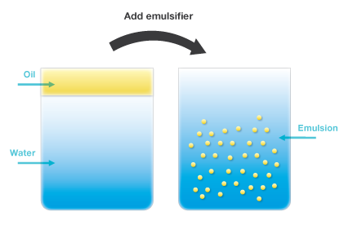
Soap as emulsifier activity
¼ tsp. oil
2 people hand soap
2 people dish soap
Explain how soap washed away the oil better than just using water
What is an emulsifier?

Slide 20
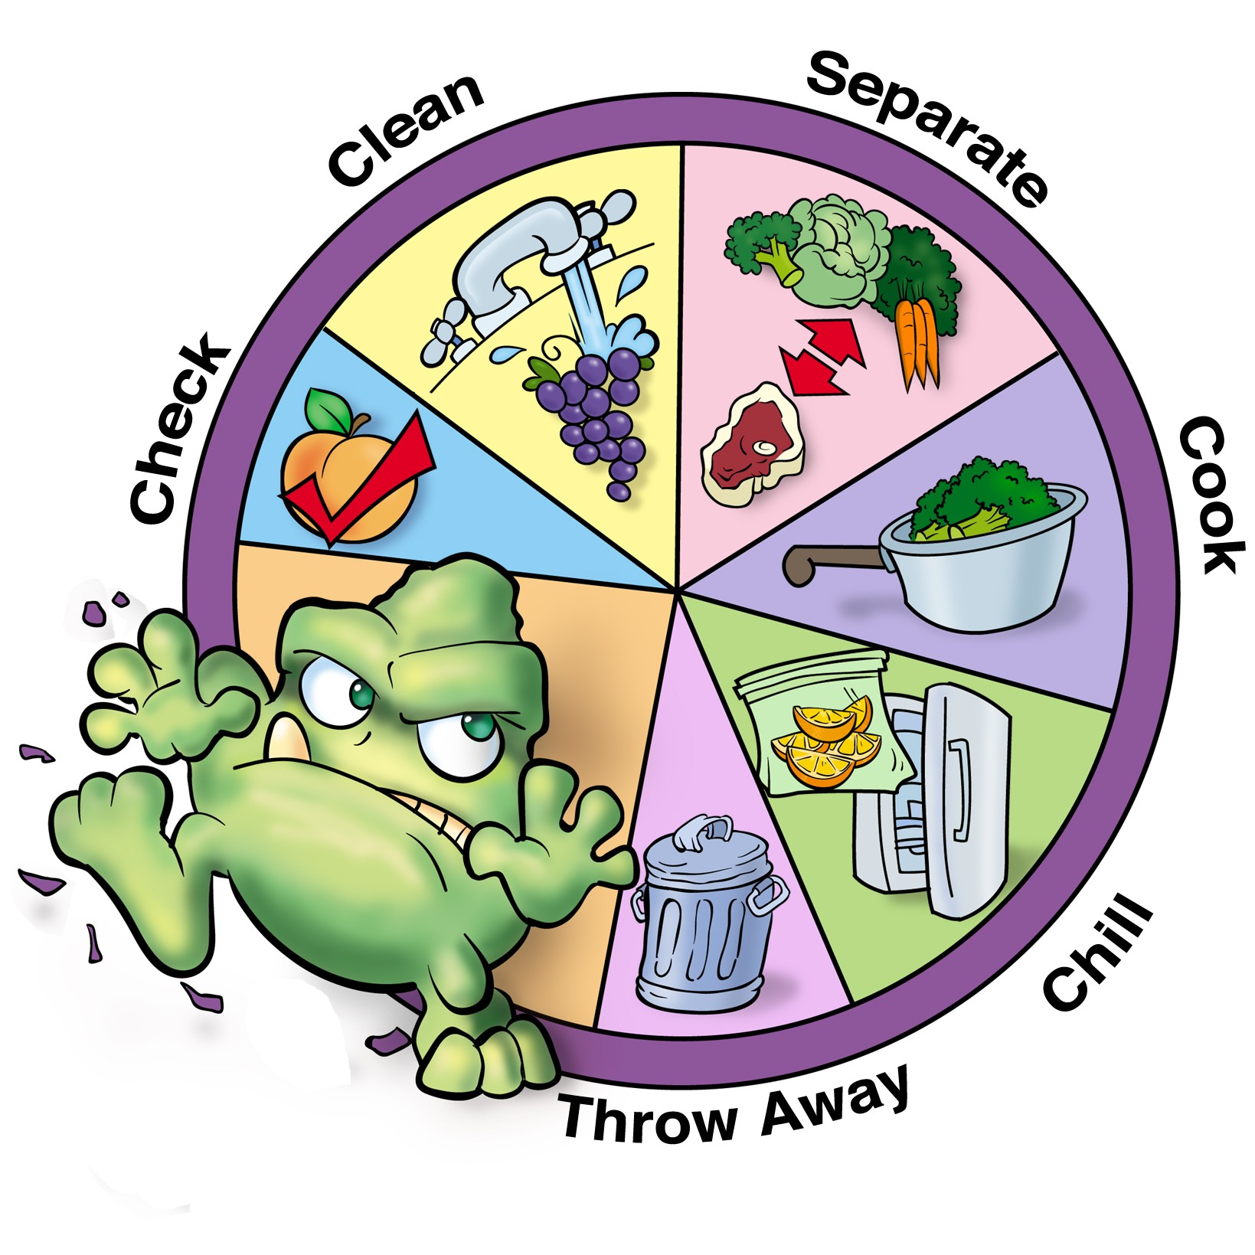
STEPS TO FOOD SAFETY – Team activity
Clean
Separate
Cook
Chill
Cooking for special occasions
Eating safely when eating out / storing food for emergencies
DUE FOR FULL CREDIT NEXT PERIOD

Slide 21

Wednesday, August 19th
BELL RINGER: record meatball recipe in your composition book, this should be recipe #2
REMINDER: Did you turn in your “Steps to Food Safety” group project?

Slide 22
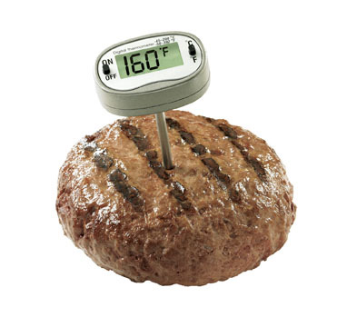
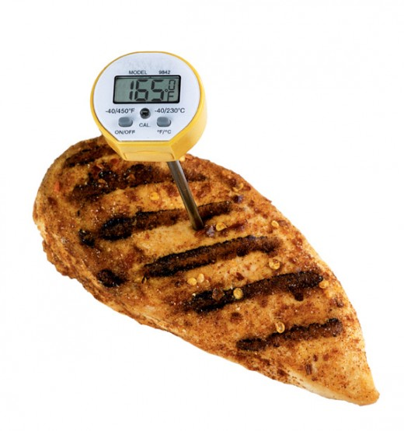
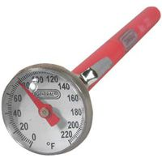
AGENDA
INTRODUCE THERMOMETERS AND THEIR USES
DISCUSS INTERNAL TEMPERATURES FOR FOOD SAFETY
MEATBALL FOOD LAB… DON’T FORGET THE PROPER UNIFORM

Slide 23
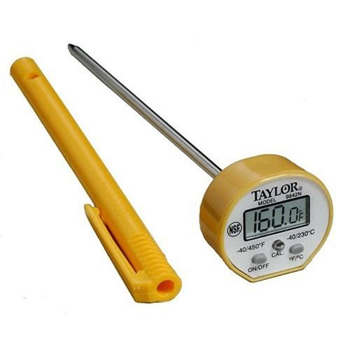

Thermometers
Bimetallic stemmed – 0 – 220 degrees HOT AND COLD FOODS
Where do we place the thermometer?
How long should we wait?

Slide 24
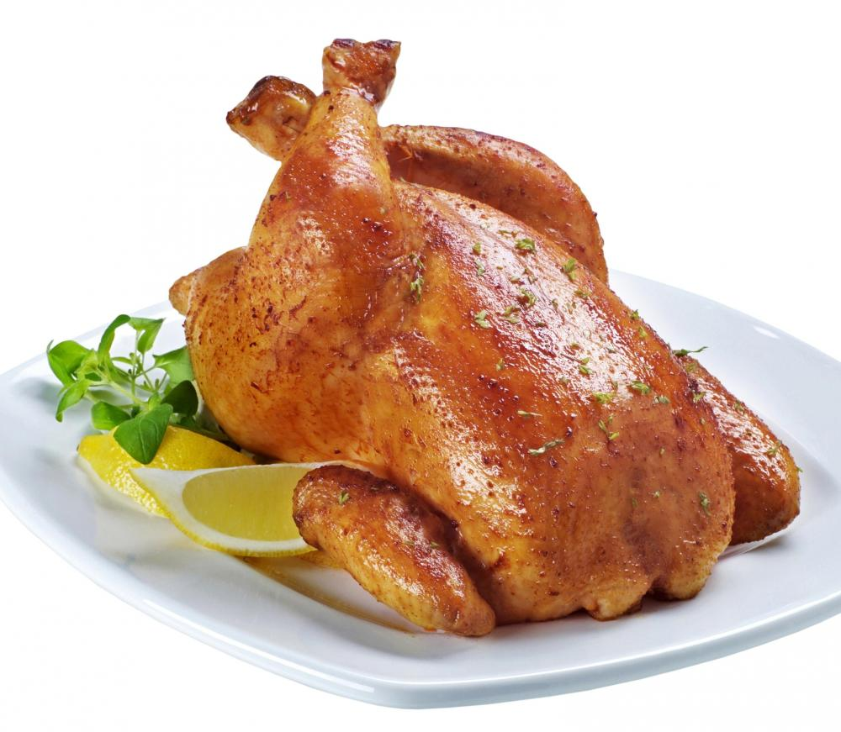
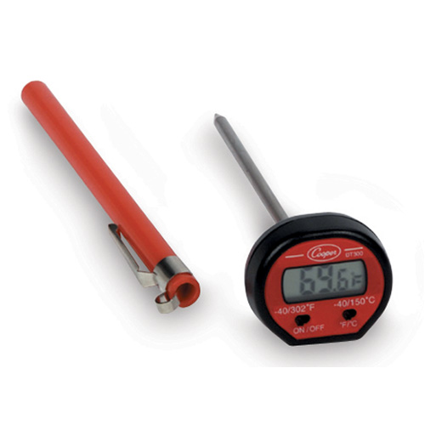
INTERNAL TEMPERATURES
FOR FOOD SAFETY
Minimum Internal Temp. | Type of Food | Wait time
165 F | Poultry (whole or ground) | 15 sec.
155 F | Ground meat (beef / pork) | 15 sec.
145 F | Seafood | 15 sec.
145 F | Roasts (pork, veal, lamb, beef) | 4 min.

Slide 25

Don’t forget to turn in your group
Project before you leave today ☺
Attach white grade sheet

Slide 26
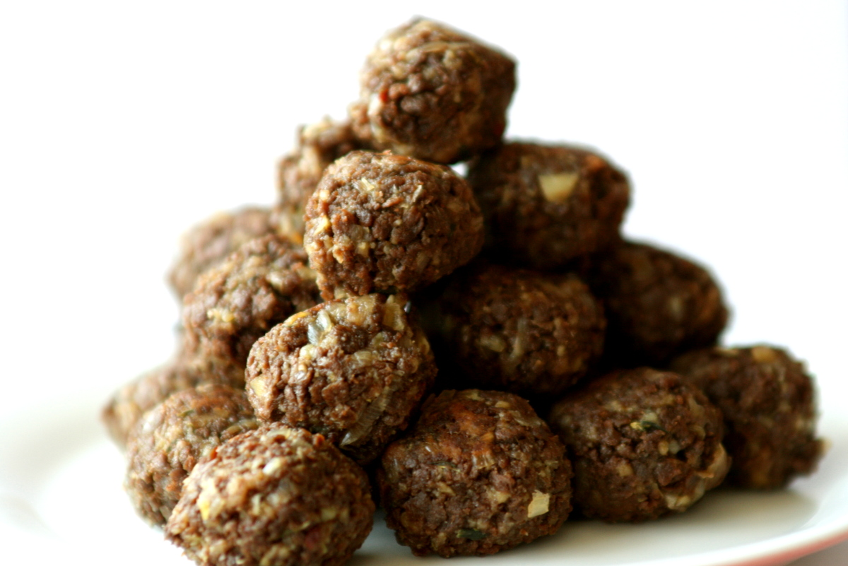
Meatball Lab – 45 min. Lab
Onion Flakes
Sanitation Buckets
Keep area Sanitary
No eating in kitchen

Slide 27

Thiede’s World
Expectations
Routine
Being Prepared

Slide 28
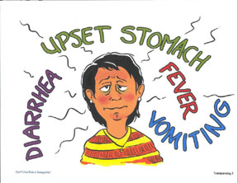
Thursday, August 20th
Bell Ringer… DEFINE: Foodborne illness, contaminant, microorganism, and bacteria (all pg. 115)
REMINDER: Safety and Sanitation Test
next Wednesday… Formal Lab Friday

Slide 29

AGENDA…
4.1 Investigate Microorganisms found in food and their role in food-borne illness
What is Food borne illness? Outbreak?
Three categories of food hazards
Microbes that cause foodborne illnesses (sources, symptoms, treatment)
HACCP – Food management system used in the industry

Slide 30
What is a foodborne illness? 5:34 min
While the American food supply is among the safest in the world, the Federal government estimates that there are about 48 million cases of foodborne illness annually—the equivalent of sickening 1 in 6 Americans each year. And each year these illnesses result in an estimated 128,000 hospitalizations and 3,000 deaths
http://www.fda.gov/Food/FoodborneIllnessContaminants/FoodborneIllnessesNeedToKnow/default.htm

Slide 31

Physical
Chemical
Biological hazards
Bacteria that cause food borne illnesses = pathogens
Think, Pair, Share

Slide 32
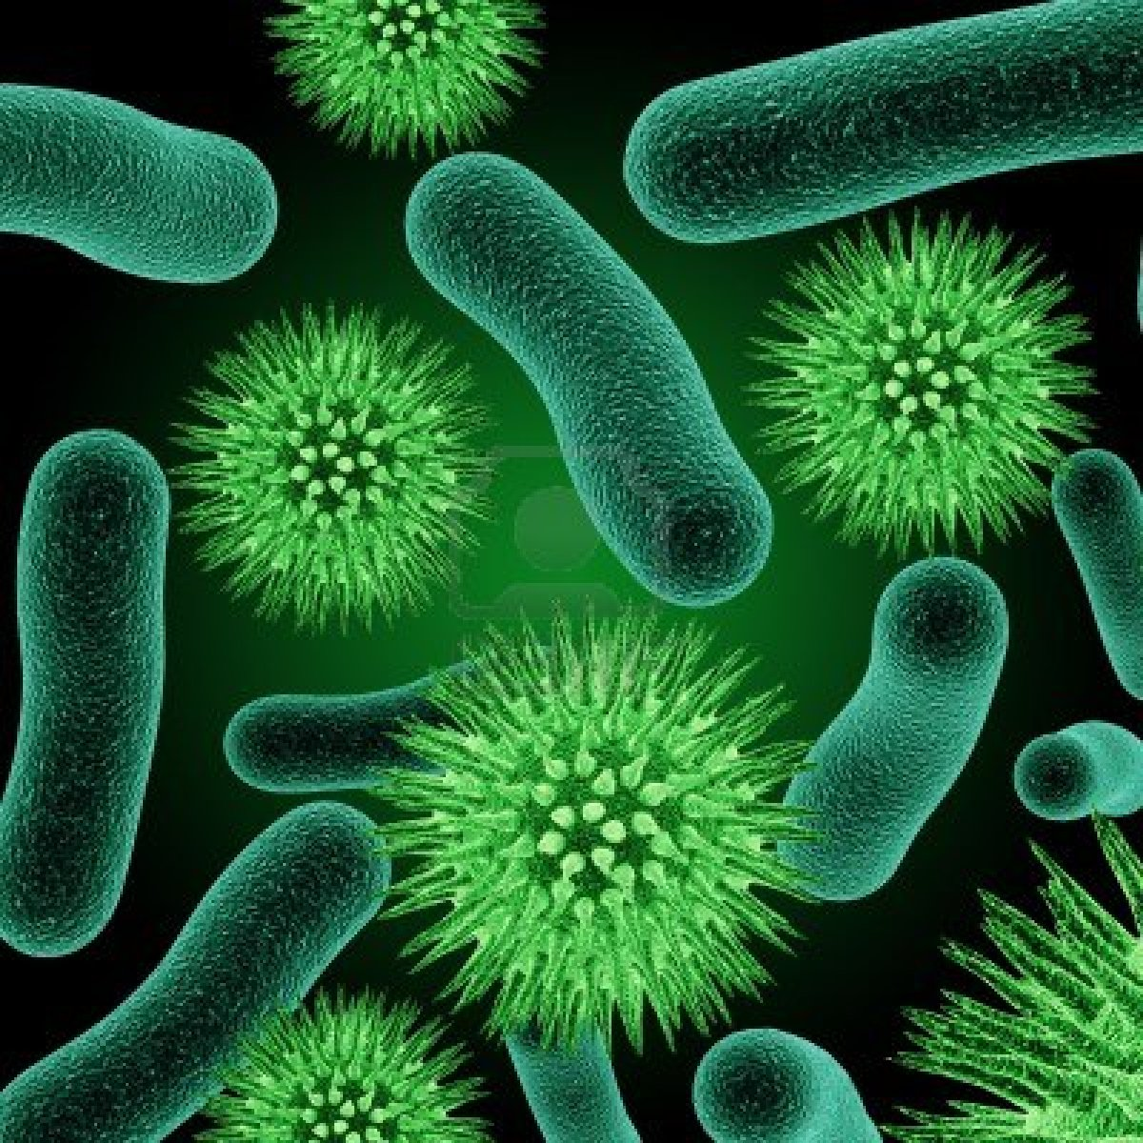
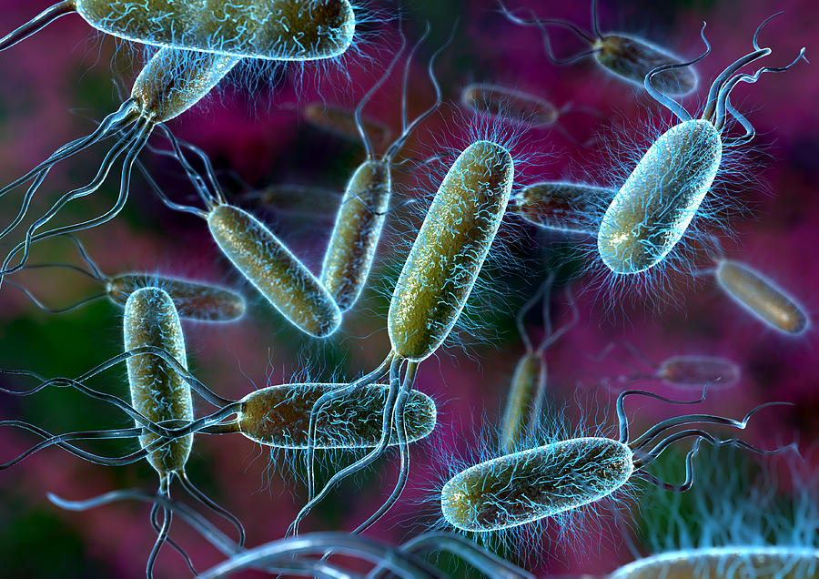
Types of Bacteria that cause an illness
Foodborne Illness worksheet
Dr. X 15 min. video
Address 4 points
5 additional things learned

Slide 33

H - Hazard
A - Analysis
C – Critical
C - Control
P Point
TCS foods - time and temp control for safety

Slide 34
Review what you learned…
Two circles – outside
30 seconds for each person to speak after introduction

Slide 35
Monday, August 24th
Safety in the kitchen rotation stations
Types of fire - Using Fire Extinguisher
First Aide
Degrees of burn
Slips, trips, and falls
Study Guide
4 steps to food safety (Chill, Cook, Separate, Clean) use posters on wall

Slide 36
Wednesday, August 26th
Unit Test
Take the first 10 minutes to do a group review
When finished record formal lab recipe in Comp book
Half recipe
Price out recipe
Introduce Formal Lab Grading Expectations

